Slide 1
#EUProjectTrails
WP3: Changing Technology, Mismatching and On-The-Job Training
Paul Redmond, Luke Brosnan ESRI
TRAILS 5th Plenary Meeting, Amsterdam
08/05/2026

Slide 2
Overview
Work Package 3: Status Update
Deliverable 3.3: Preliminary Estimates
Discussion
Amsterdam (8 May, 2026)

Slide 3
WP3: Status Update
Deliverable 3.1:
  Delivered in December 2024, Published January 2025
  Chapter 1: Accepted to special edition of Journal of Education and Work
  Chapter 3: Revise & Resubmit to British Journal of Industrial Relations
  Dissemination: Presented at Irish Economic Association Conference (Northern Ireland, May 2025), SkillsPULSE Project Seminar (Poland, June 2025), ELMI Conference (Poland, October 2025), EARLALL annual meeting in Belgium (November 2025)
Deliverable 3.2:
  Delivered in December 2025, Published January 2026
Amsterdam (8 May, 2026)

Slide 4
WP3: Deliverable D3.3
Overview of D3.3
Sectoral analysis of the relationship between educational mismatch and labour market outcomes in Europe
Leader: ESRI (Participants: AUTH, UNINA, Tilburg University)
D3.3 Due on in M32 (August 2026)
Results presented here are preliminary and subject to change.
Amsterdam (8 May, 2026)

Slide 5
Motivation & Research Question
Why It Matters
Educational mismatch is widespread across European labour markets, with significant consequences for workers and firms
Mismatch is linked to wage penalties, lower job satisfaction, and reduced job security
No consensus on best measurement approach — the choice of measure can yield conflicting estimates
Sectoral heterogeneity in mismatch effects is understudied — most analyses pool across industries
Research Questions
RQ1 Do the labour market effects of educational mismatch differ across sectors?
RQ2 Does the choice of mismatch measure (subjective vs. statistical) change the estimated effects?
RQ3 Are “doubly mismatched” workers worse off than those flagged by only one measure?
RQ4 The moderating role of training
Outcomes: wages, job satisfaction, job security
Amsterdam (8 May, 2026)

Slide 6
Literature & Measurement
Mismatch effects on wages and job quality are well-documented (McGuinness et al., 2018; Leuven & Oosterbeek, 2011). The central methodological debate is how to measure mismatch.
Subjective Measure
Workers self-report required education level for their job; compared to actual qualifications
Advantage: captures actual job demands as experienced by the worker
Limitation: susceptible to reporting bias and endogeneity
Sloane et al. (1999); Chevalier (2003)
Statistical (Mode) Measure
Modal education level for each occupation taken as benchmark; individual deviation = mismatch
Advantage: objective, replicable, not subject to self-report bias
Limitation: assumes the mode is the “required” level; misses within-occupation variation
Hartog (2000); Verdugo & Verdugo (1989)
Expected sign of mismatch effects: Under education controls, undereducated workers earn a wage premium (they bring more education than the job strictly requires) and overeducated workers face a penalty. Under occupation controls the signs reverse — occupation fixed effects absorb job quality, so within-occupation variation dominates (Hartog, 2000; Leuven & Oosterbeek, 2011; McGuinness, 2006).
This study: We use both measures and a combined typology to examine whether “doubly mismatched” workers face compounded disadvantage, and whether effects differ across sectors.
Amsterdam (8 May, 2026)

Slide 7
Data
European Skills and Jobs Survey (CEDEFOP)
  “ The European skills and jobs survey (ESJS) is Cedefop’s own periodic EU-wide survey aimed at collecting information on the skill requirements, skill mismatches and initial and continuing learning of adult workers in EU labour markets. ”
Wave 2 : Collected in 2021
Includes: sociodemographic characteristics; job characteristics; job-skill requirements; skill mismatches; labour market outcomes
Amsterdam (8 May, 2026)

Slide 8
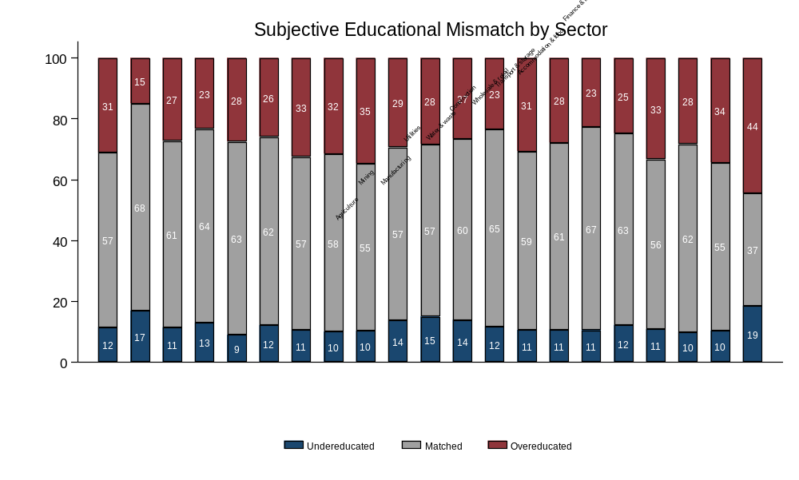
Amsterdam (8 May, 2026)

Slide 9
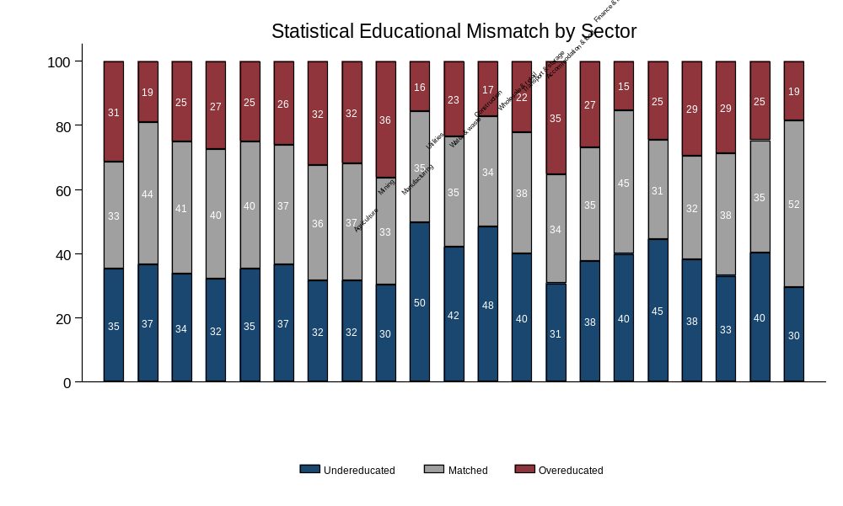
Amsterdam (8 May, 2026)

Slide 10
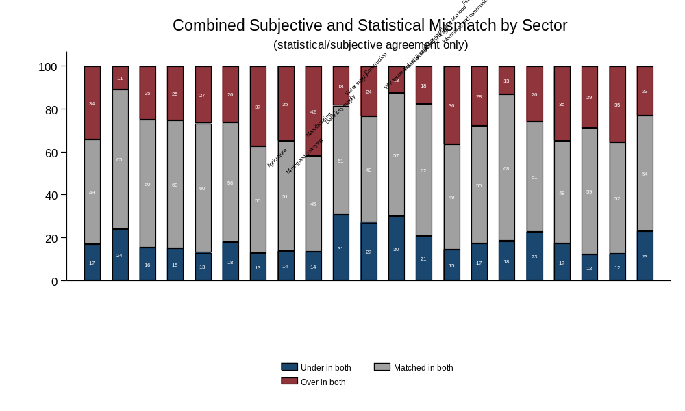
Amsterdam (8 May, 2026)

Slide 11
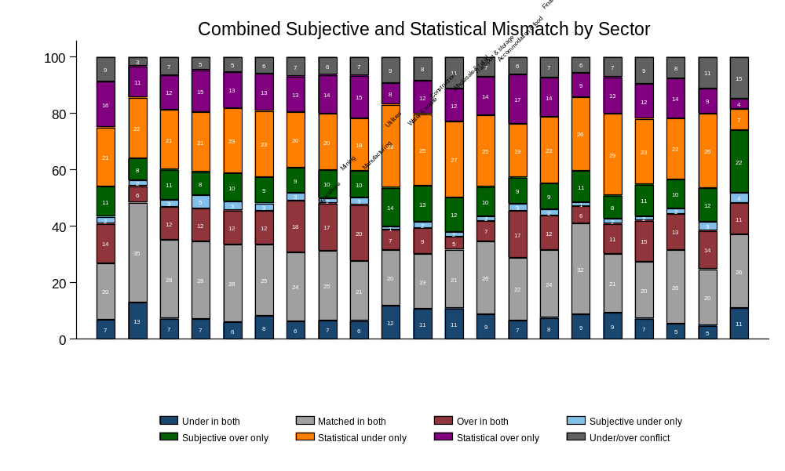
Amsterdam (8 May, 2026)

Slide 12
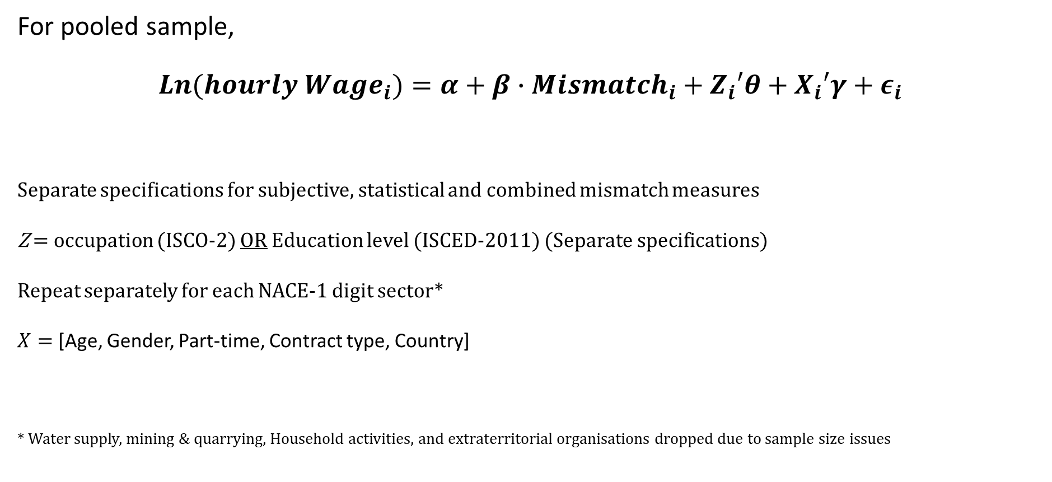
Wage effects of educational mismatch
For pooled sample,
$${Ln(hourly Wage}_{i})=α+β∙{Mismatch}_{i}+{Z_{i}′θ+X}_{i}′γ+ε_{i}$$
Separate specifications for subjective, statistical and combined mismatch measures
Z = occupation (ISCO-2) OR Education level (ISCED-2011) (Separate specifications)
Repeat separately for each NACE-1 digit sector*
$X=$ [Age, Gender, Part-time, Contract type, Country]
* Water supply, mining & quarrying, Household activities, and extraterritorial organisations dropped due to sample size issues
Amsterdam (8 May, 2026)

Slide 13
Pooled wage regressions
 | (1) | (2) | (3) | (4) | (5) | (6)
VARIABLES | education controls | ISCO2 controls | education controls | ISCO2 controls | education controls | ISCO2 controls
Subjective mismatch (ref: Matched)
Undereducated | 0.110*** | -0.022**
 | (0.009) | (0.009)
Overeducated | -0.155*** | -0.055***
 | (0.007) | (0.006)
Statistical mismatch (ref: Matched)
Undereducated |  |  | 0.095*** | -0.135***
 |  |  | (0.009) | (0.007)
Overeducated |  |  | -0.114*** | 0.105***
 |  |  | (0.009) | (0.008)
Combined mismatch (ref: Matched in both)
Undereducated in both |  |  |  |  | 0.175*** | -0.111***
 |  |  |  |  | (0.012) | (0.011)
Overeducated in both |  |  |  |  | -0.237*** | 0.014
 |  |  |  |  | (0.011) | (0.010)
Subjective undereducated only |  |  |  |  | 0.101*** | 0.057***
 |  |  |  |  | (0.020) | (0.020)
Subjective overeducated only |  |  |  |  | -0.090*** | -0.076***
 |  |  |  |  | (0.010) | (0.010)
Statistical undereducated only |  |  |  |  | 0.082*** | -0.139***
 |  |  |  |  | (0.010) | (0.008)
Statistical overeducated only |  |  |  |  | -0.068*** | 0.149***
 |  |  |  |  | (0.011) | (0.011)
Statistical/subjective conflict |  |  |  |  | -0.052*** | -0.181***
 |  |  |  |  | (0.014) | (0.013)
Observations | 32,133 | 32,133 | 32,650 | 32,650 | 32,133 | 32,133
R-squared | 0.576 | 0.570 | 0.574 | 0.580 | 0.582 | 0.581
Amsterdam (8 May, 2026)

Slide 14
Sector-level regressions
Amsterdam (8 May, 2026)

Slide 15
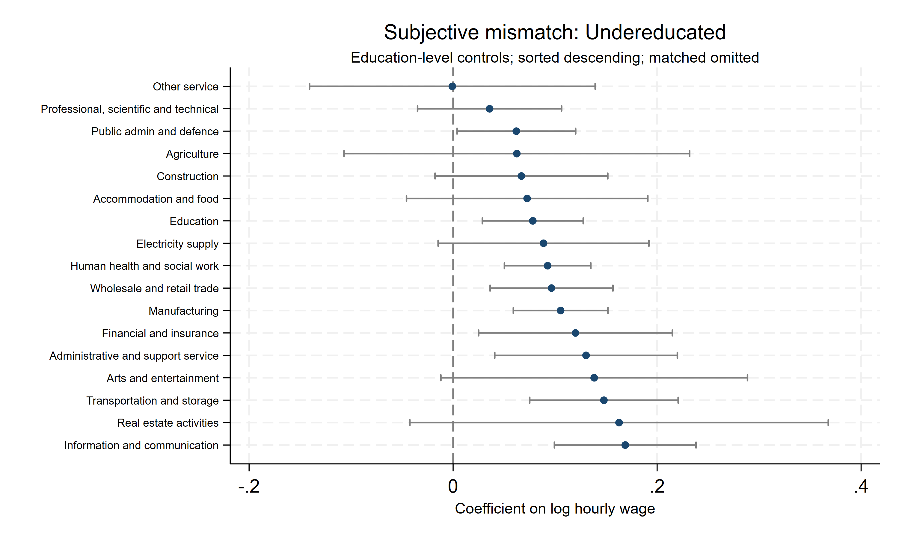
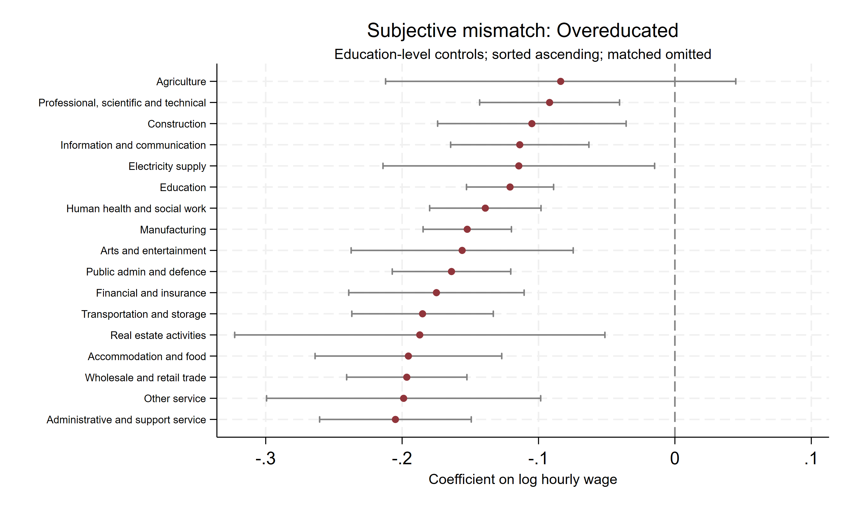
Subjective; Education controls
Amsterdam (8 May, 2026)

Slide 16
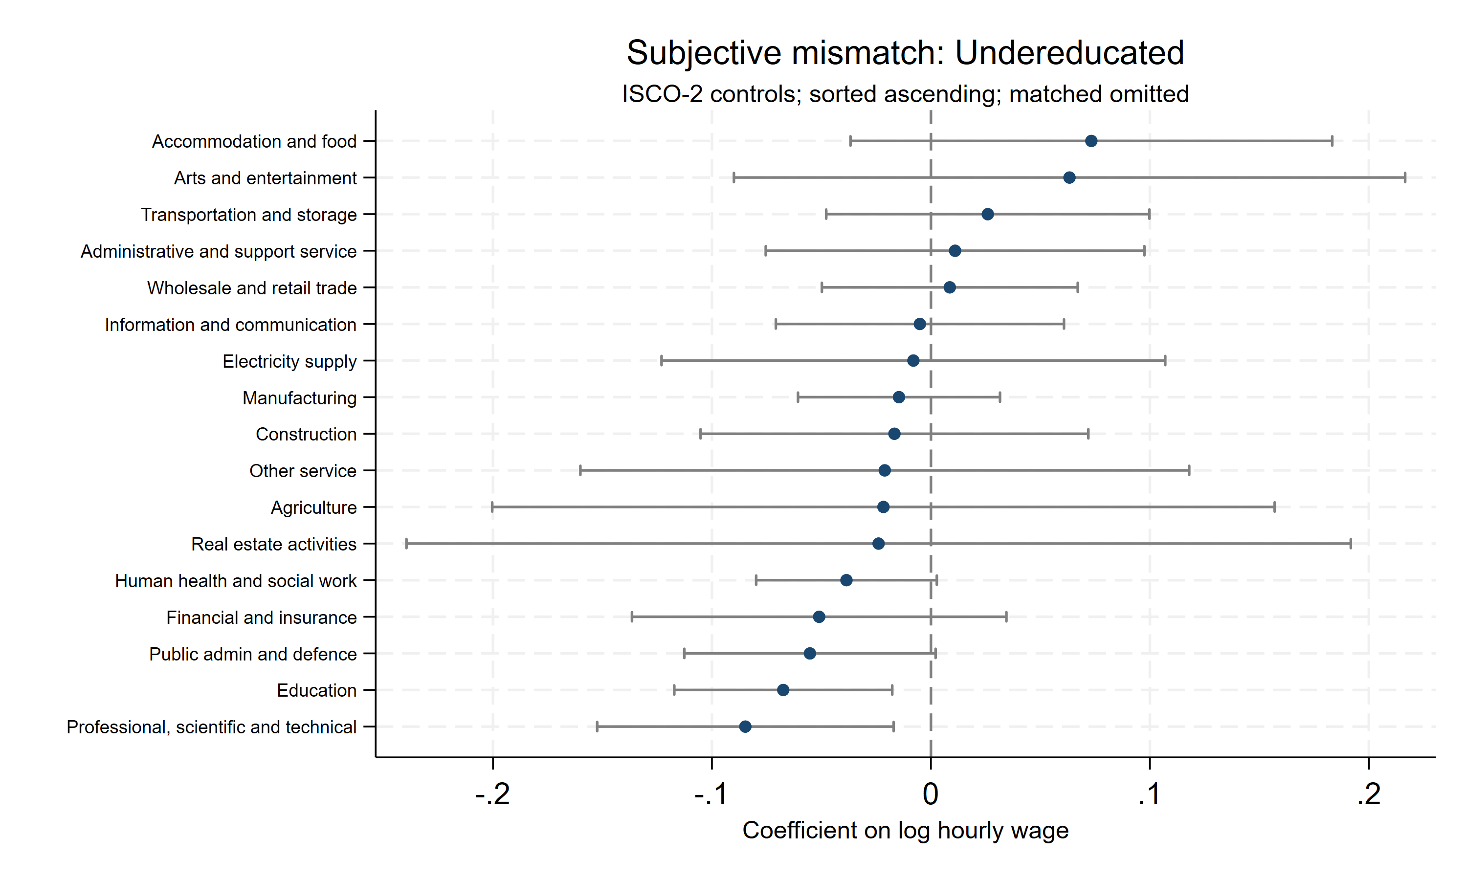
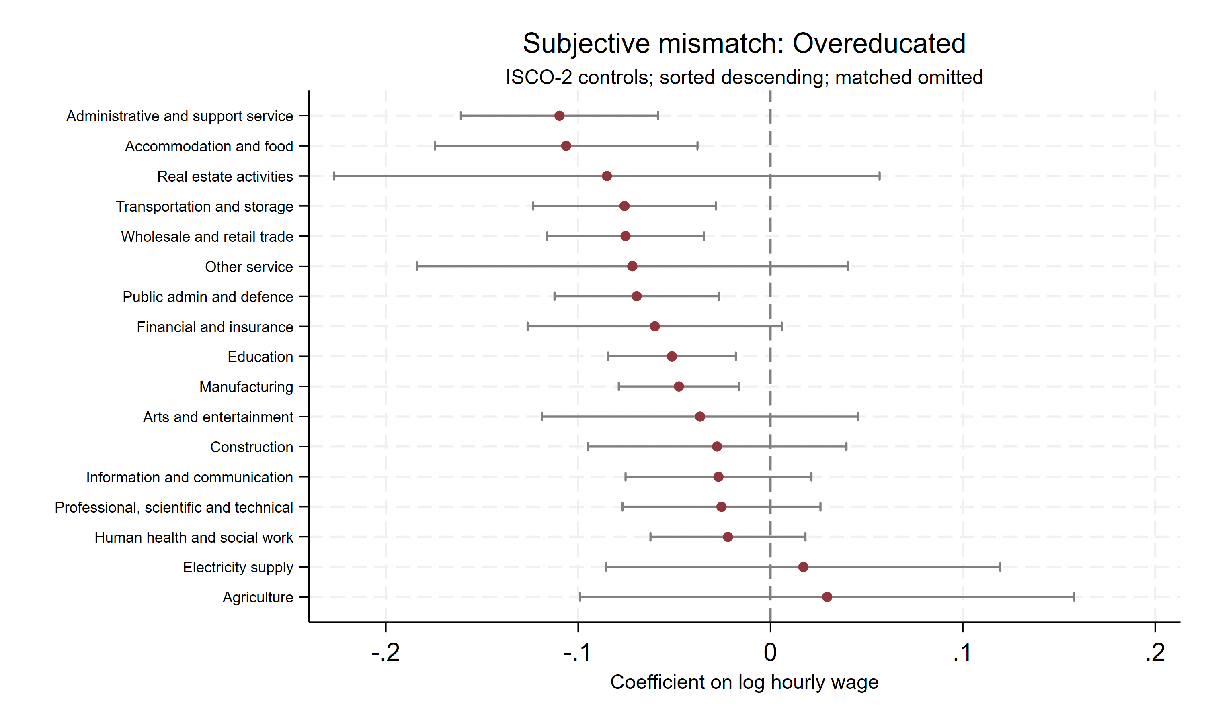
Subjective; Occupation controls
Amsterdam (8 May, 2026)

Slide 17
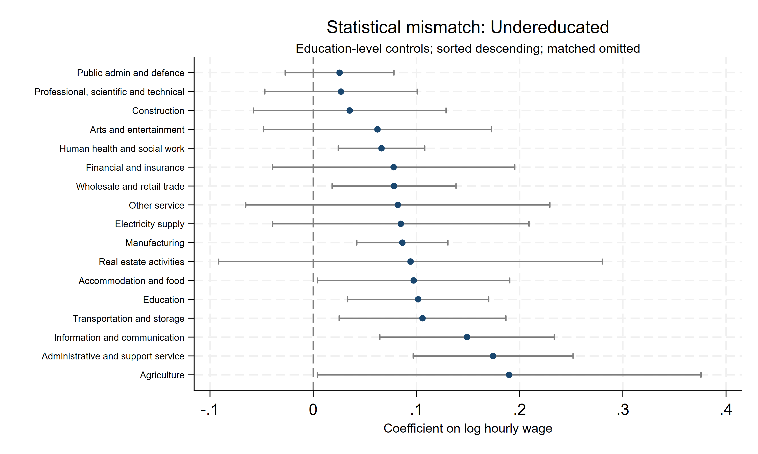
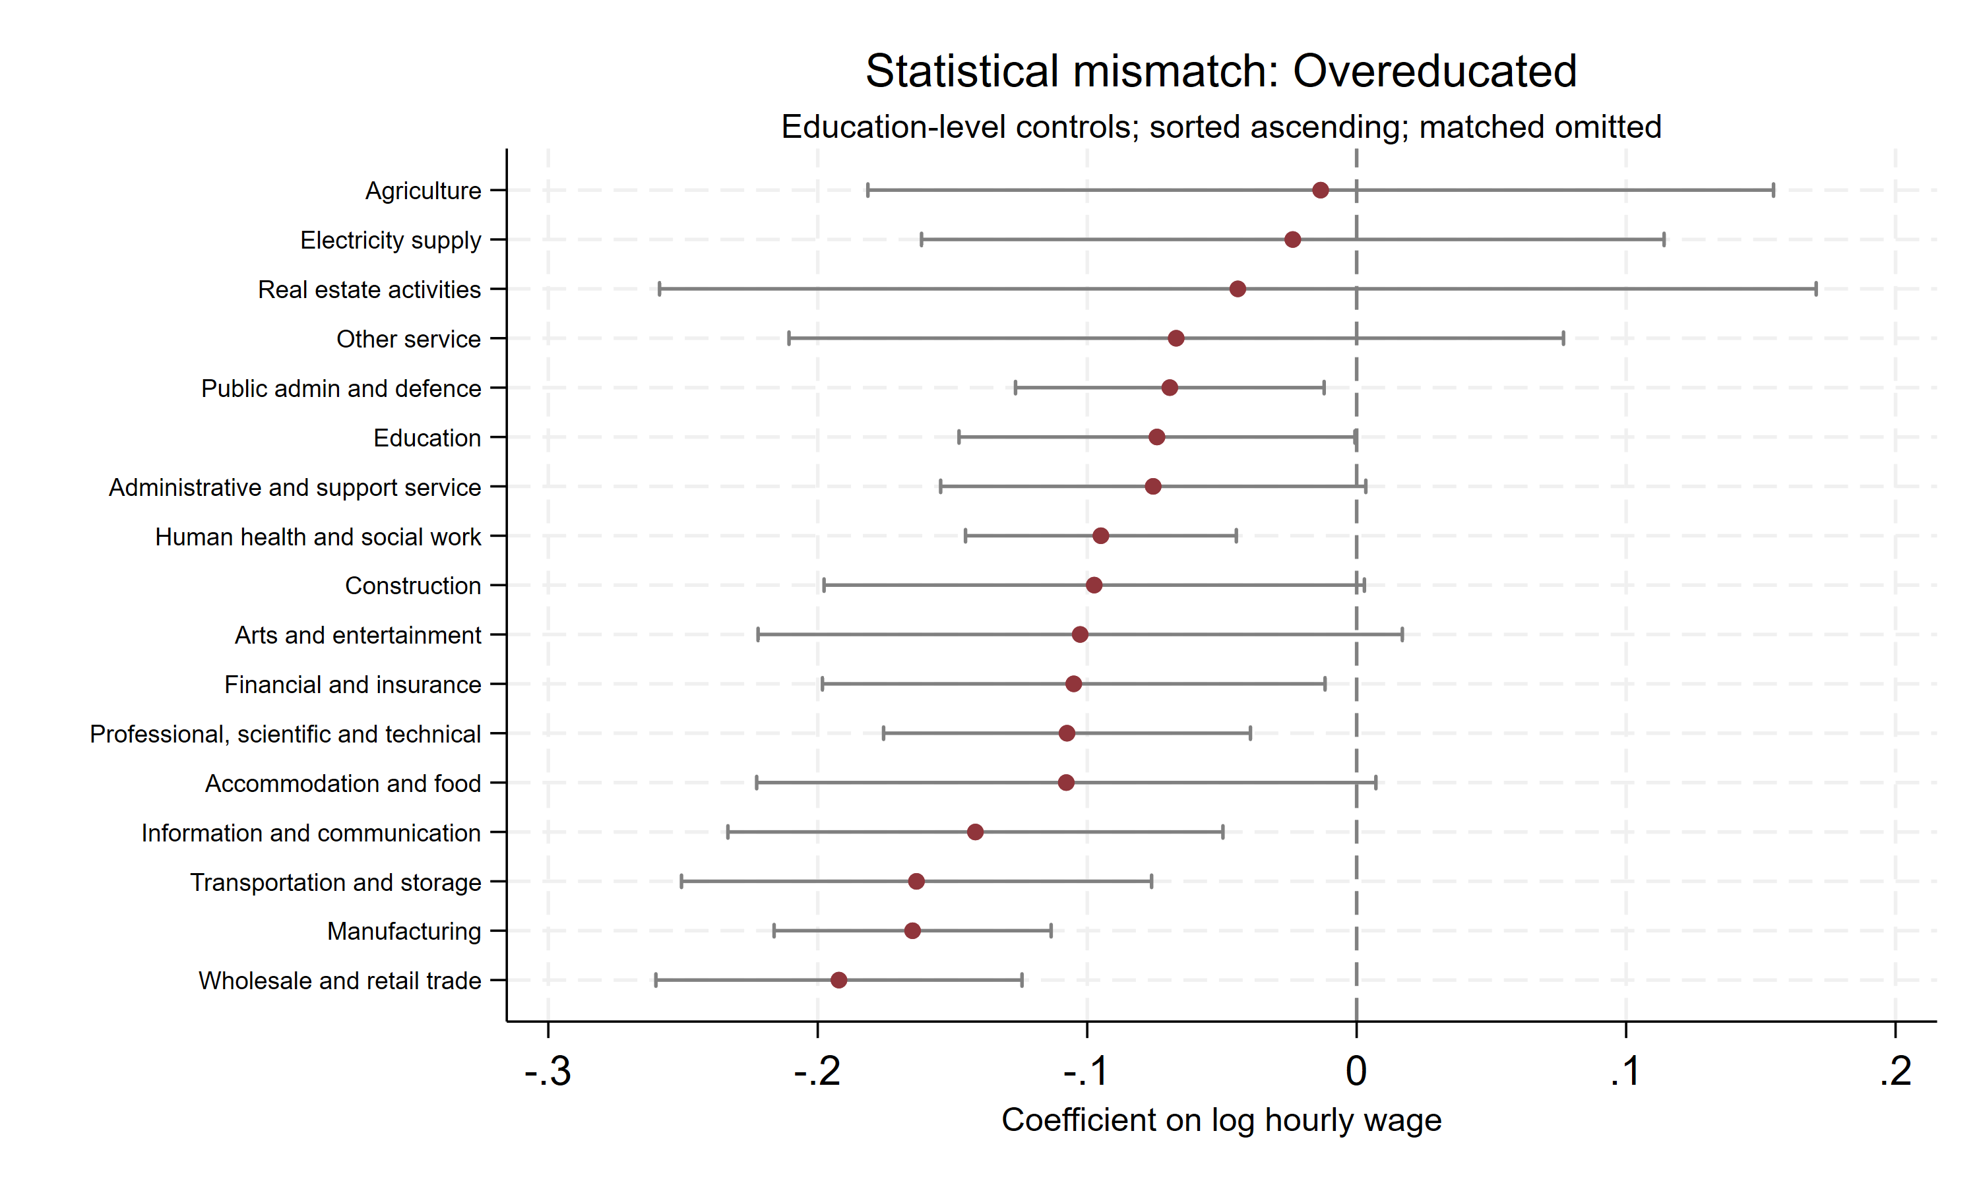
Statistical; Education controls
Amsterdam (8 May, 2026)

Slide 18
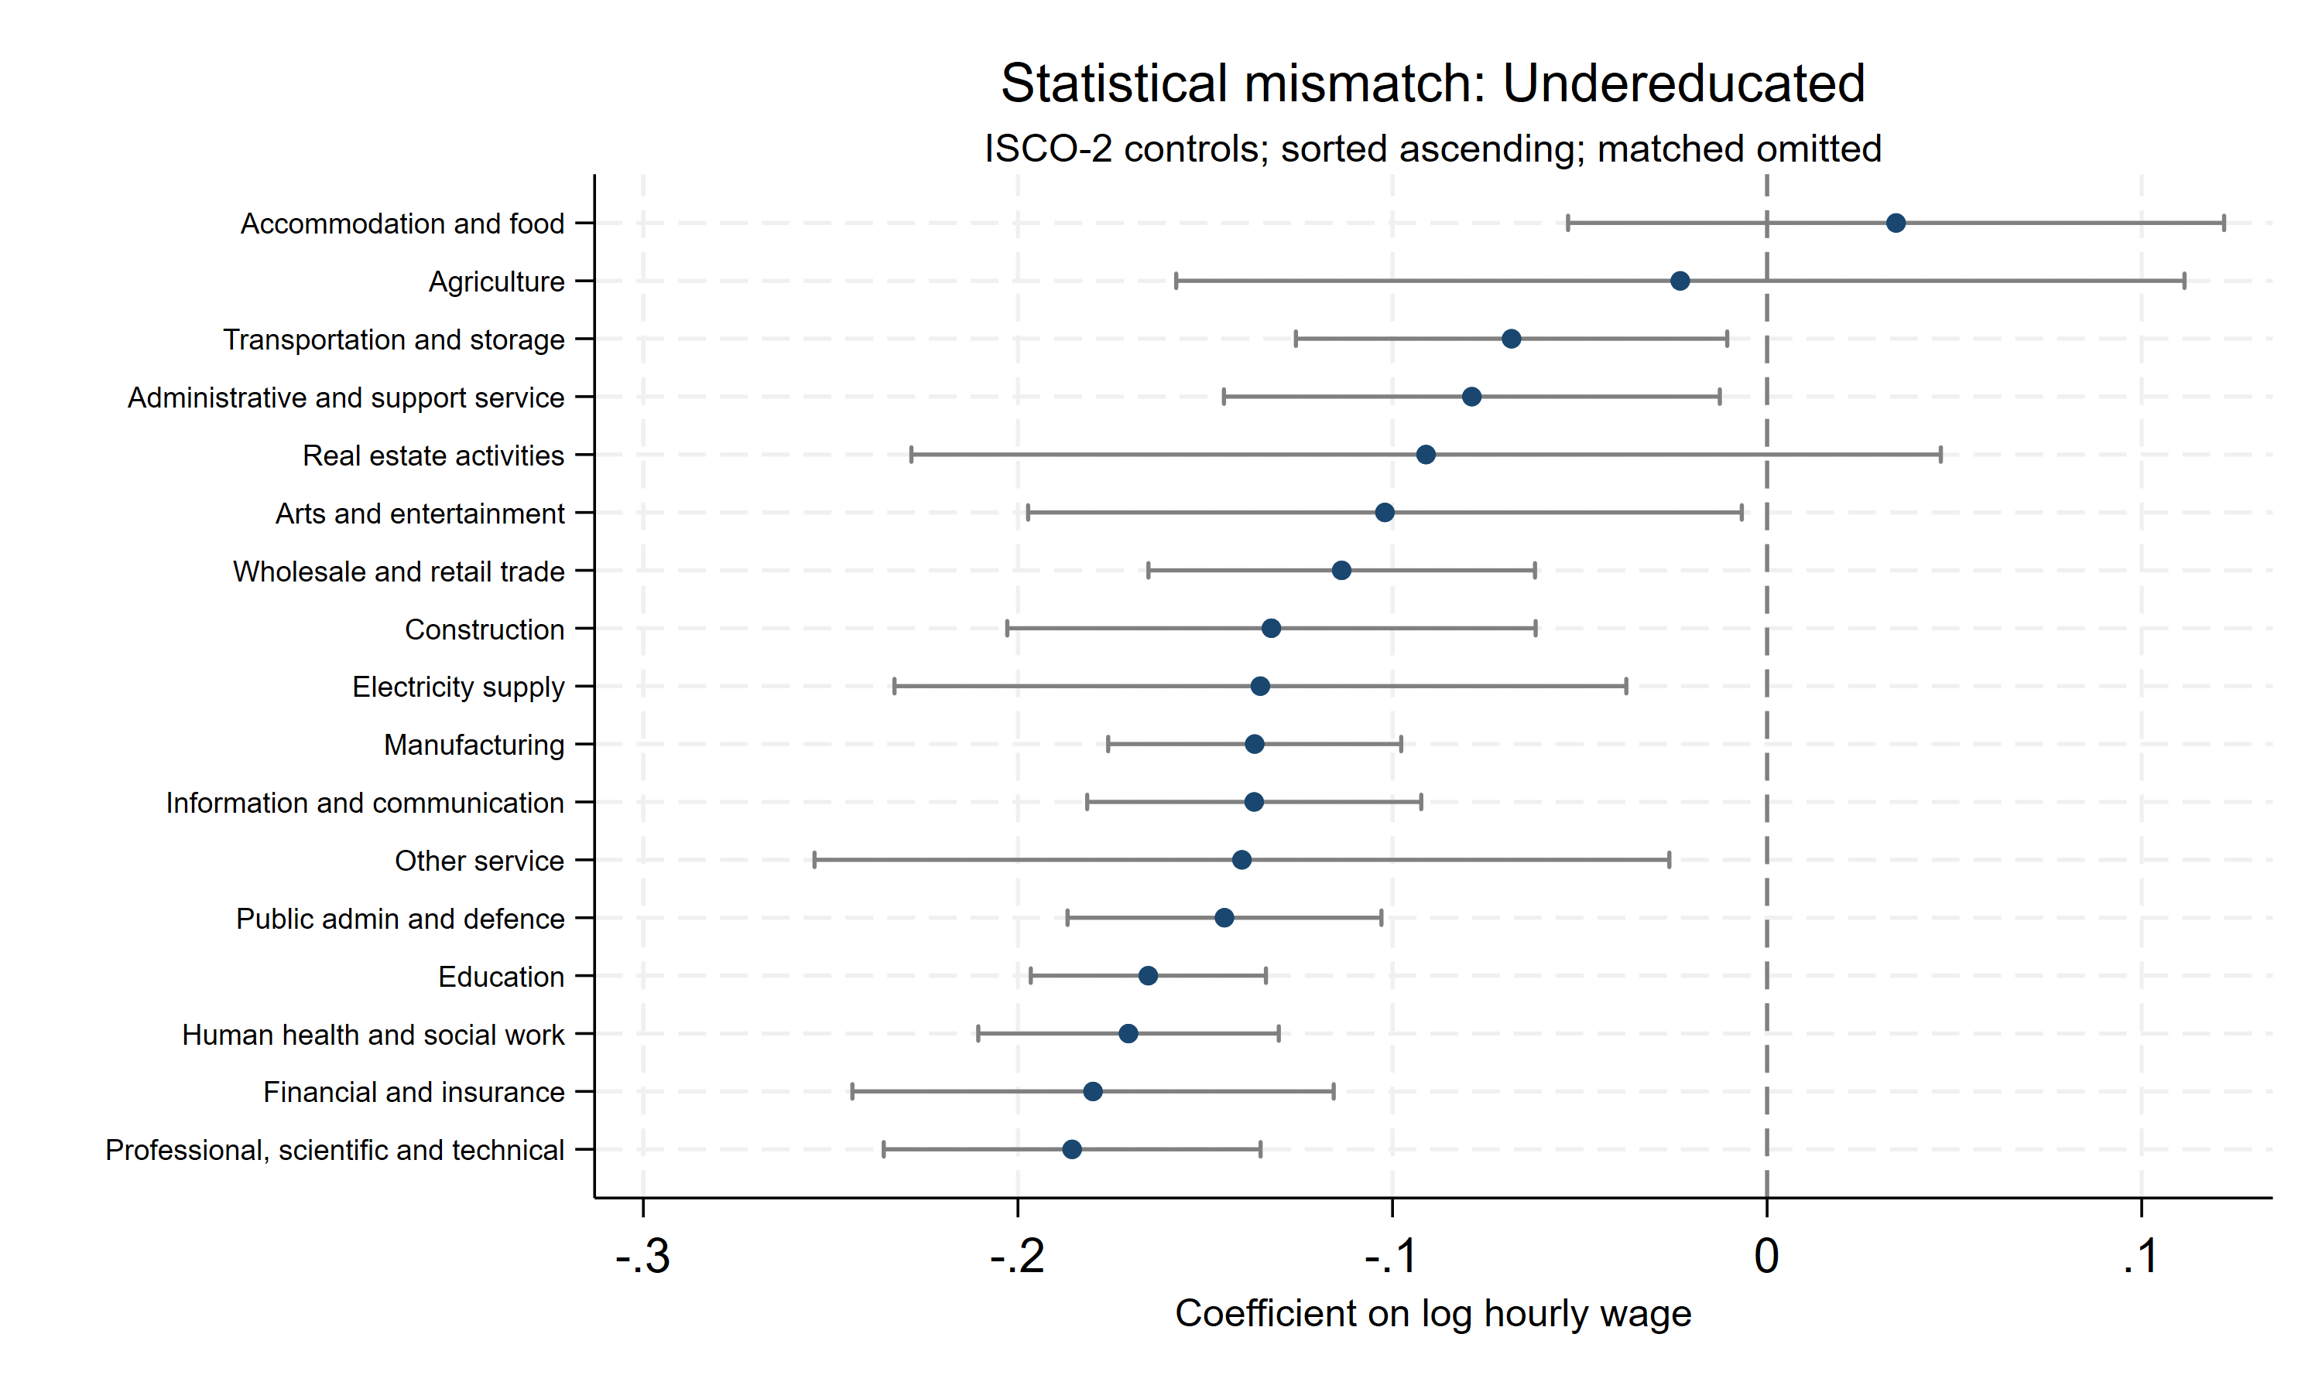
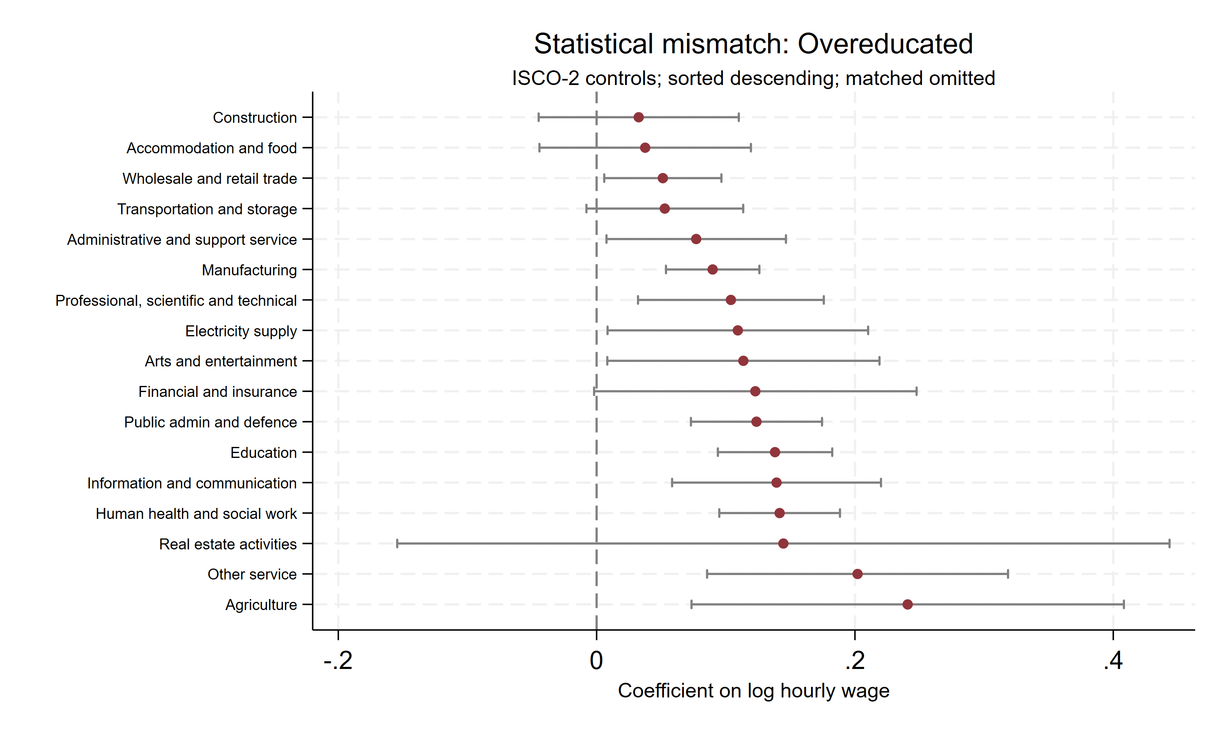
Statistical; Occupation controls
Amsterdam (8 May, 2026)

Slide 19
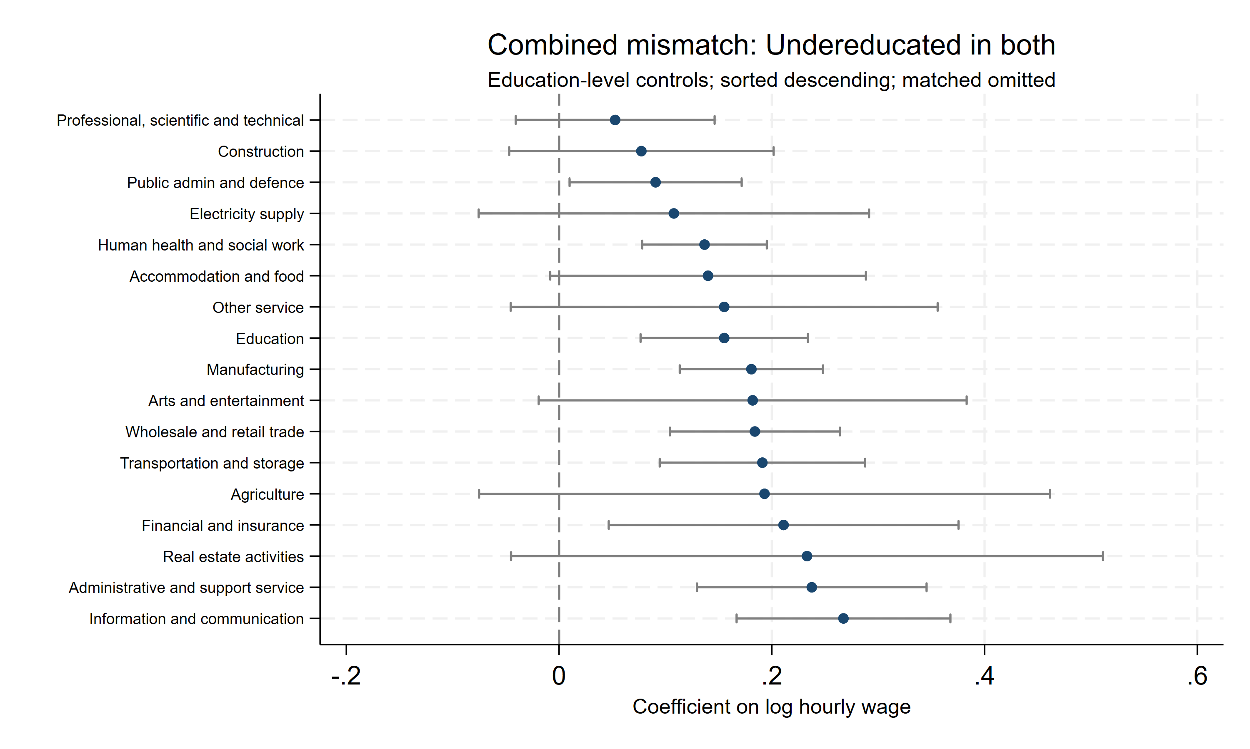
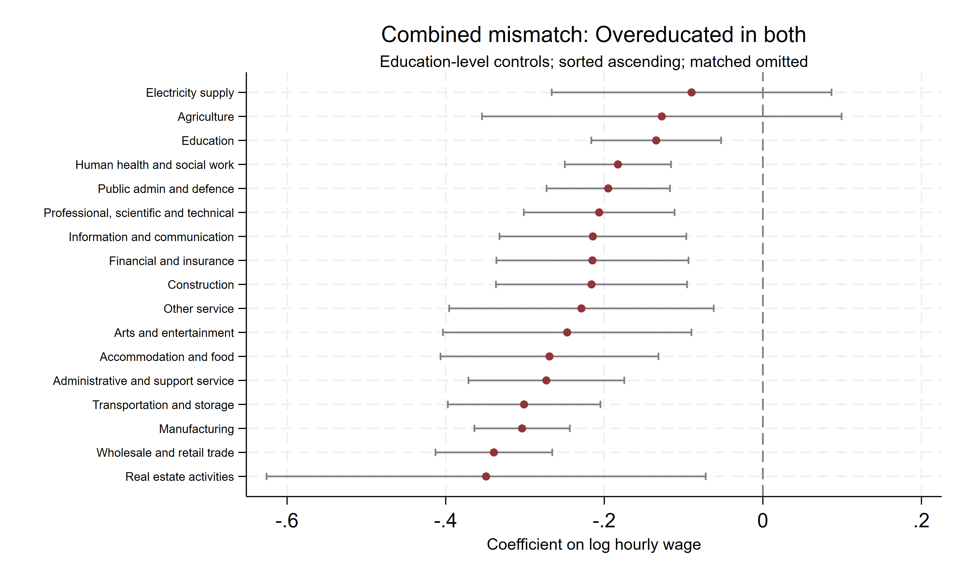
Combined; Education controls
Amsterdam (8 May, 2026)

Slide 20
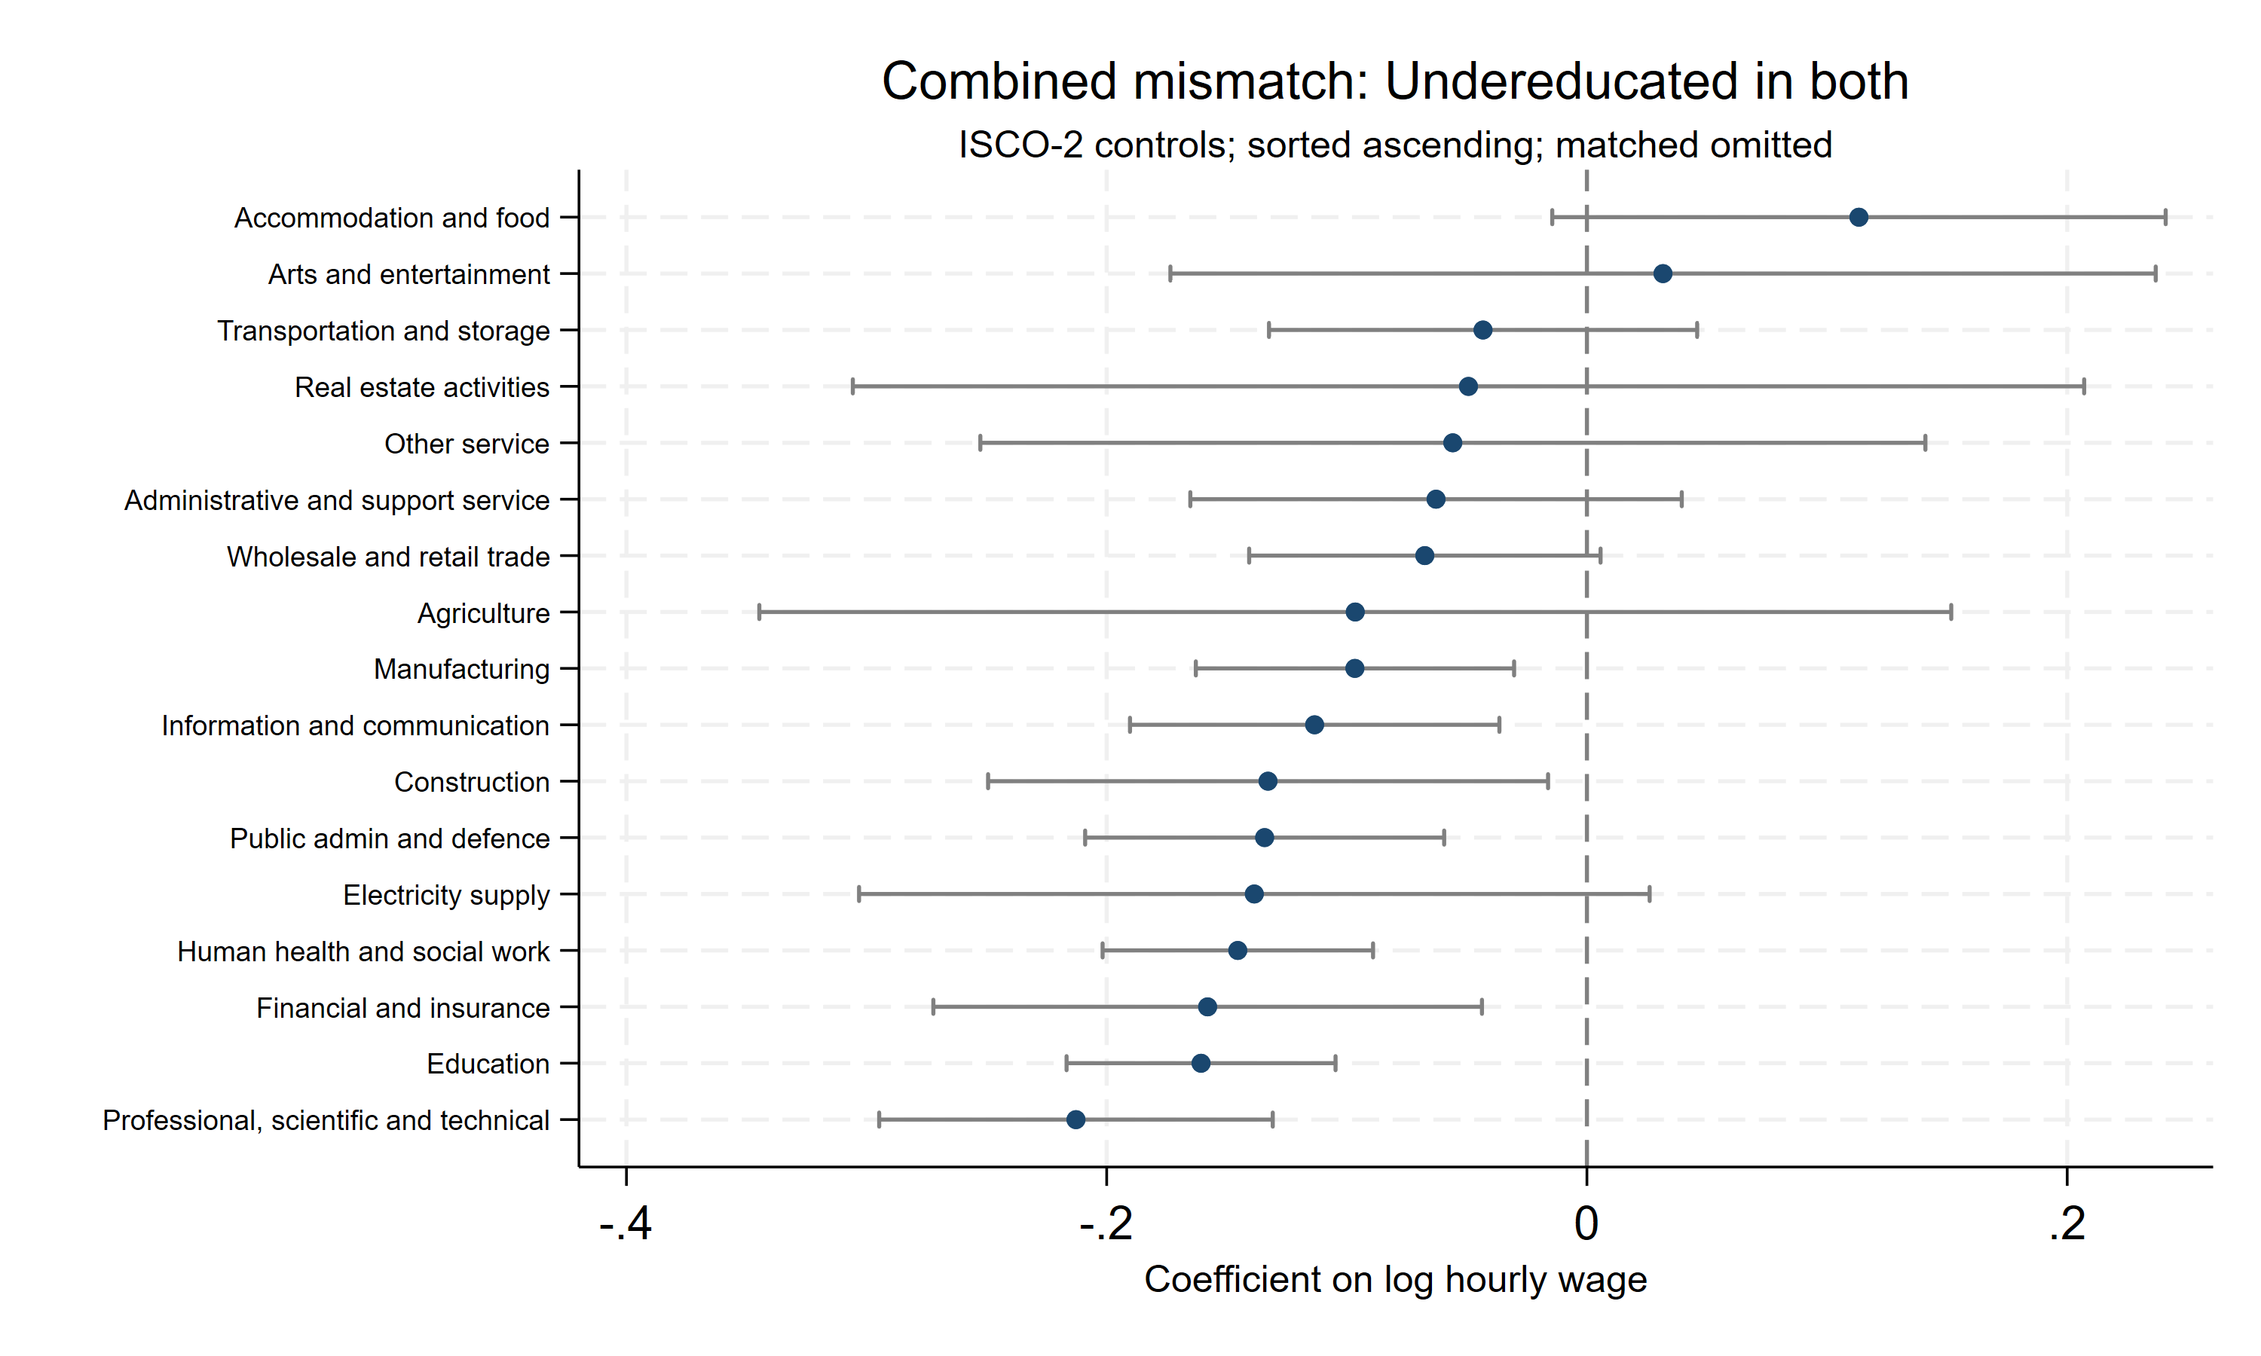
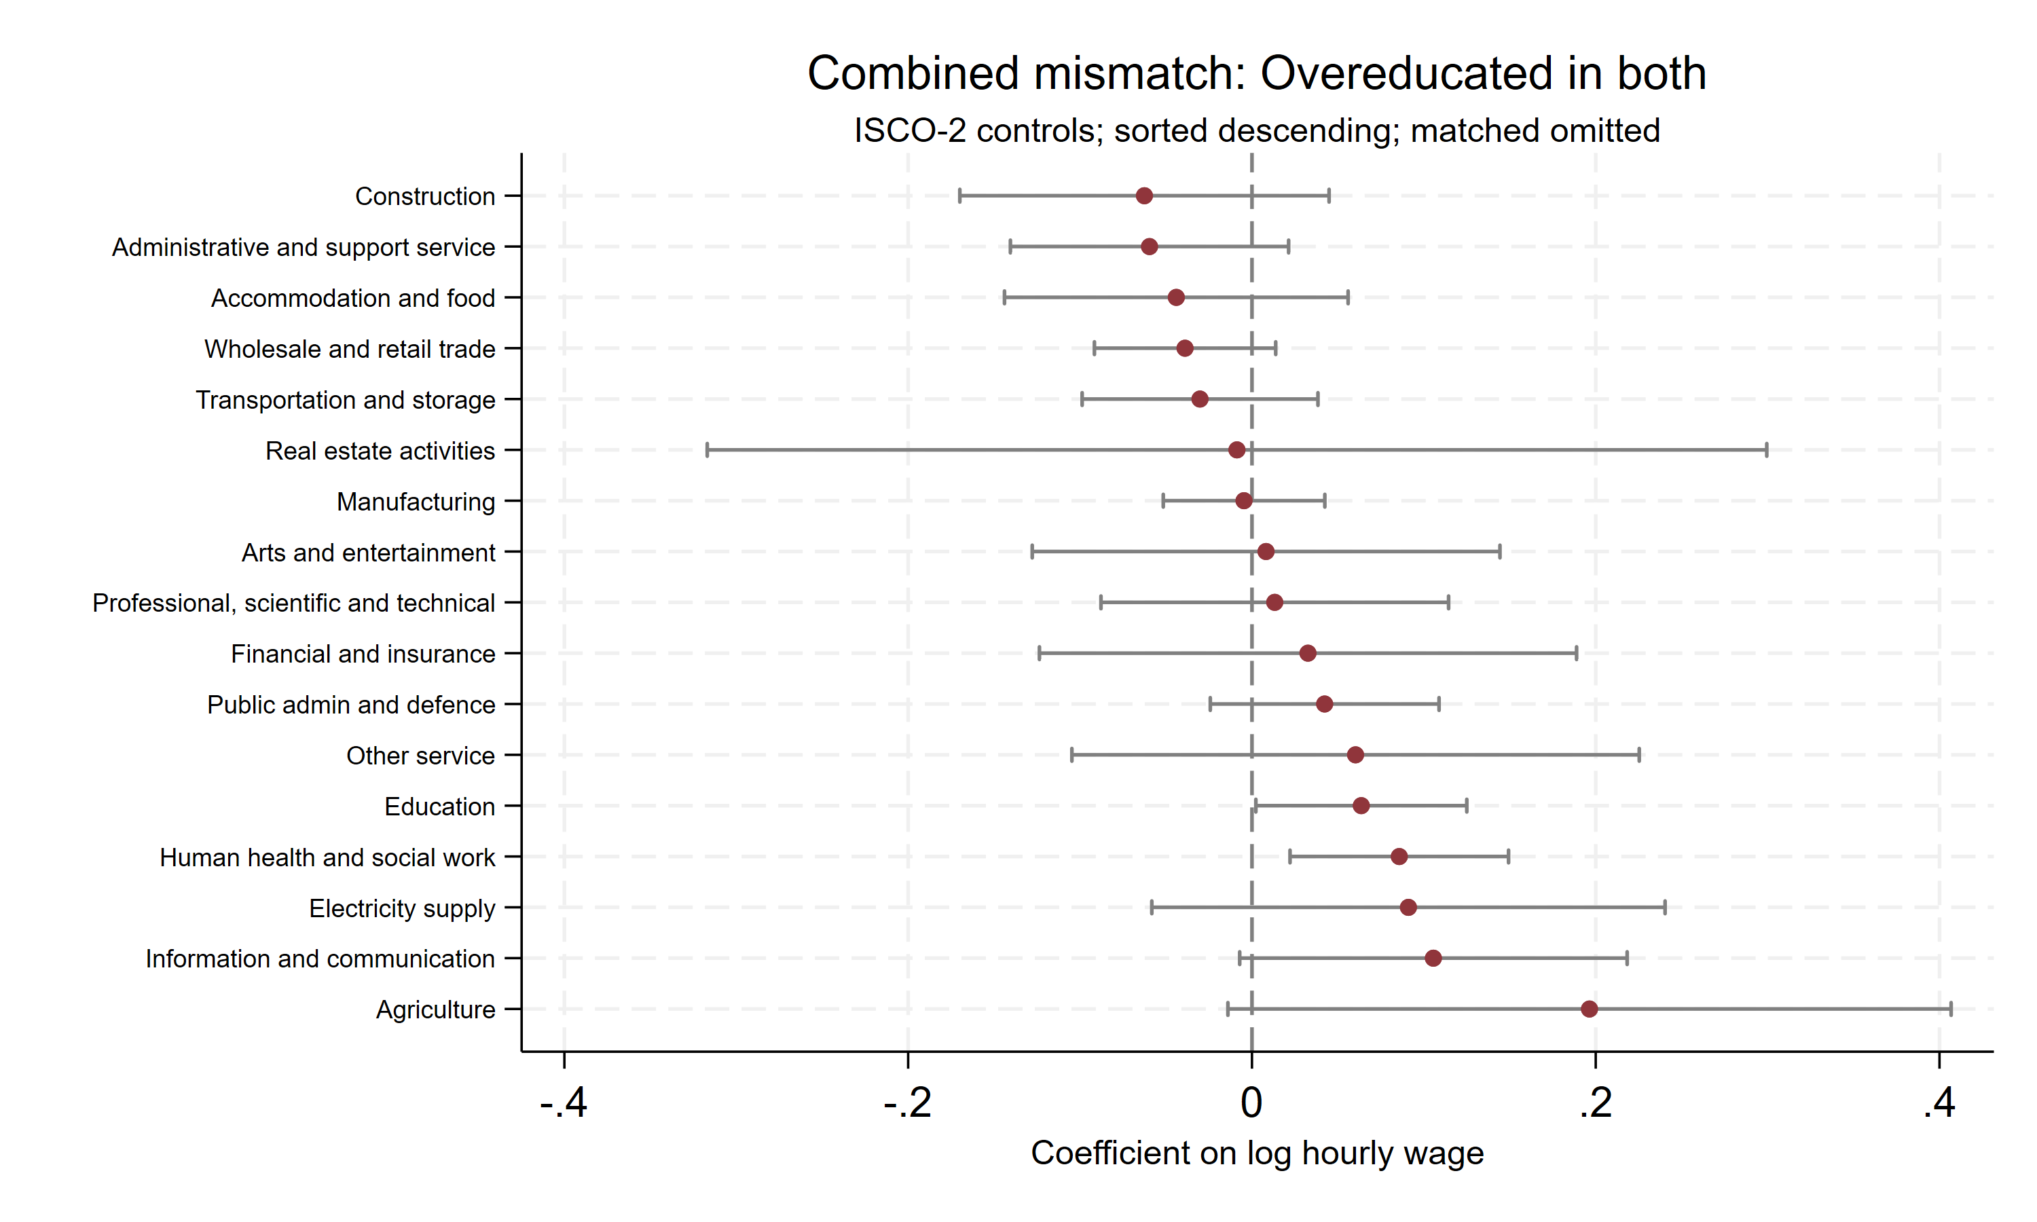
Combined; Occupation controls
Amsterdam (8 May, 2026)

Slide 21
Preliminary Conclusions & Next Steps
Preliminary Findings
Overeducation is associated with a wage penalty across both measures, but the magnitude varies substantially by measure and sector
Subjective and statistical measures frequently disagree, with only a subset of workers flagged as mismatched by both
Workers flagged as overeducated under both measures face the largest wage penalties, suggesting compounded disadvantage
Sectoral heterogeneity is evident — mismatch effects differ meaningfully across NACE-1 digit sectors
Results subject to change; control choice affects estimates
Next Steps
1 Extend analysis to job satisfaction and job security outcomes
2 Complete sector-by-sector regressions for all mismatch typologies
3 Role of training
4 Policy implications: translate findings for skills strategy and VET policy discussions
D3.3 due August 2026 (M32)
Amsterdam (8 May, 2026)

Slide 22
Discussion

Slide 23
Contact u
Contact us
trails-project.eu
Dr Paul Redmond
paul.redmond@esri.ie
linkedin.com/company/trails-enabling-data-analytics-for-actions-tackling-skills-shortages-and-mismatch
#EUProjectTrails

Slide 24
References
Chevalier, A. (2003). Measuring over-education. Economica, 70(279), 509–531.
Hartog, J. (2000). Over-education and earnings: Where are we, where should we go? Economics of Education Review, 19(2), 131–147.
Leuven, E., & Oosterbeek, H. (2011). Overeducation and mismatch in the labor market. In E. A.
Hanushek, S. Machin, & L. Woessmann (Eds.), Handbook of the economics of education (Vol. 4, pp. 283–326). Elsevier.
McGuinness, S. (2006). Overeducation in the labour market. Journal of Economic Surveys, 20(3), 387–418.
McGuinness, S., Pouliakas, K., & Redmond, P. (2018). Skills mismatch: Concepts, measurement and policy approaches. Journal of Economic Surveys, 32(4), 985–1015.
Sloane, P. J., Battu, H., & Seaman, P. T. (1999). Overeducation, undereducation and the British labour market. Applied Economics, 31(11), 1437–1453.
Verdugo, R. R., & Verdugo, N. T. (1989). The impact of surplus schooling on earnings: Some additional findings. Journal of Human Resources, 24(4), 629–643.
Amsterdam (8 May, 2026)

Slide 25
Plan I
Investigate the link between educational mismatch and labour market outcomes.
Educational mismatch is a scenario where an employee’s level of education does not match that require do their job
There are various ways of measuring educational mismatch:
  Subjective: an employee is asked what level of education is required to do their job, and their acquired education level is compared to that
  Statistical: The mode level of education for each job category is recorded. An employee’s education level is compared top that
Both methods have advantages and disadvantages
Amsterdam (8 May, 2026)

Slide 26
Plan II
Compare the incidence of outcomes (overeducation, matched, undereducation) by sector using both forms of measurement and also a combination of both measures:
  Matched in both: Subjective matched and statistical matched
  Undereducated in both: Subjective undereducated and statistical undereducated
  Overeducated in both: Subjective overeducated and statistical overeducated
  Subjective under only: Subjective says undereducated, but statistical matched
  Subjective over only: Subjective says overeducated, but statistical matched
  Statistical under only: Statistical says undereducated, but subjective matched
  Statistical over only: Statistical says overeducated, but subjective matched
  Under/over conflict: One measure says undereducated and the other says overeducated
Amsterdam (8 May, 2026)

Slide 27
Plan III
Determine the conditional effect each mismatch type on various labour market outcomes (wages, job satisfaction, job security) on pooled sample
Run the same analysis separately for each sector
Amsterdam (8 May, 2026)

