Slide 1



The Impact of a Minimum Wage Increase on Employment: Evidence from Ireland
Paul Redmond
Lorcan Kelly
Hugh Creaton

Slide 2

What we do in this paper…
The minimum wage in Ireland increased every year from 2016 to 2025
  Did these increases cause MW employees to lose their jobs?

Slide 3
What we do in this paper…
The minimum wage in Ireland increased every year from 2016 to 2025
  Did these increases cause MW employees to lose their jobs?
Sub-minimum wage rates exist in Ireland, meaning young workers can ‘age into’ a higher wage band.
  Do youth-rate MW workers lose their jobs when their wage entitlement goes up?

Slide 4
Channels of adjustment
Employment effects
  Existing workers losing their job (Stewart, 2004)
  A reduction in hiring (Gopalan et al., 2021)

Slide 5
Channels of adjustment
Employment effects
  Existing workers losing their job (Stewart, 2004)
  A reduction in hiring (Gopalan et al., 2021)
Hours worked
  Consistent evidence of a reduction in hours worked following a minimum wage increase (e.g., Redmond et al., 2025; Stewart and Swaffield, 2008; Caliendo et al., 2017)
Prices
  E.g., Leung (2021); Ashenfelter and Jurajda (2022)

Slide 6
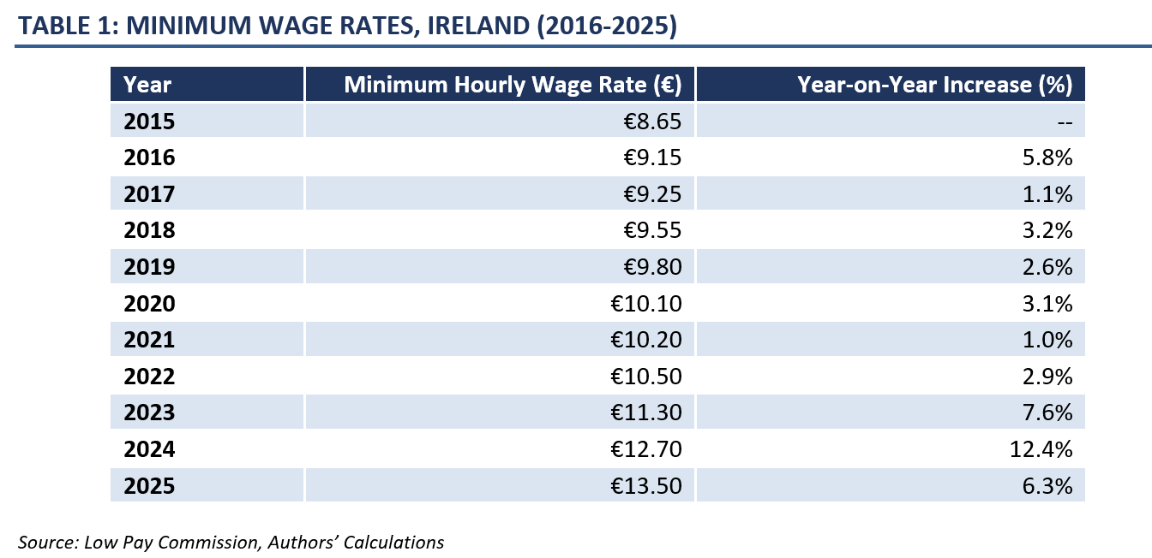
Irish Minimum Wage Policy

Slide 7
Irish Minimum Wage Policy
Age based sub-minimum youth rates
Under 18 – 70% of the full rate
18 years – 80% of the full rate
19 years – 90% of the full rate
20 and over – 100% of the full rate
Note – youth rates are not commonly used (Redmond et al., 2023)

Slide 8
Data
Irish Labour Force Survey
Minimum wage question (introduced in 2016)
Asks employees whether they earn less than, exactly, or more than the prevailing MW

Slide 9
Data
Irish Labour Force Survey
Minimum wage question (introduced in 2016)
Asks employees whether they earn less than, exactly, or more than the prevailing MW
If they earn less than the MW, they are asked for the reason
On an age-based rate that is aged 19 or younger
Employed by an immediate relative including spouse or siblings or parents or grandparents.
Participating in an apprenticeship programme
Other reason (Please specify)

Slide 10
Methodology (I)
Examine the impact of the yearly (1 January) MW increases

Slide 11
Methodology (I)
Examine the impact of the yearly (1 January) MW increases
Follow employees from quarter 4 to quarter 1
Treatment group – MW employees in quarter 4
Control group – higher paid (above MW) in quarter 4
Observe their outcomes in quarter 1 – are they employed or not?

Slide 12
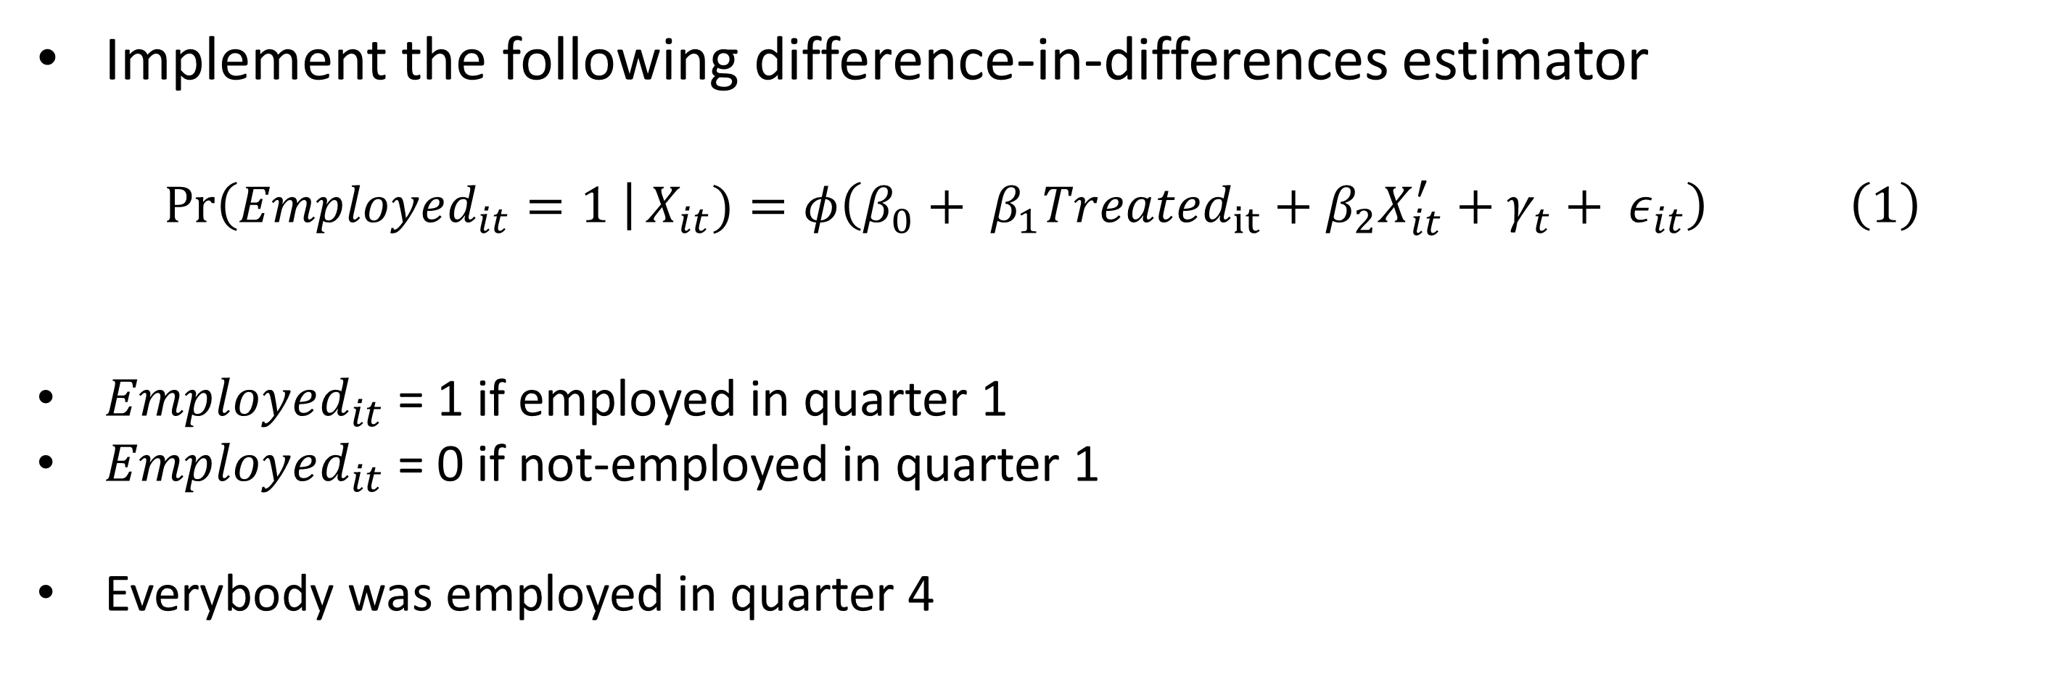
Methodology (I)
Implement the following difference-in-differences estimator
$$\operatorname{Pr}\left(Employed_{it}=1 \right|X_{it})=φ\left(β_{0}+ β_{1}{Treated}_{it}+β_{2}X_{it}^{′}+γ_{t}+ ε_{it}\right) \left(1\right)$$
$Employed_{it}$ = 1 if employed in quarter 1
$Employed_{it}$ = 0 if not-employed in quarter 1
Everybody was employed in quarter 4

Slide 13
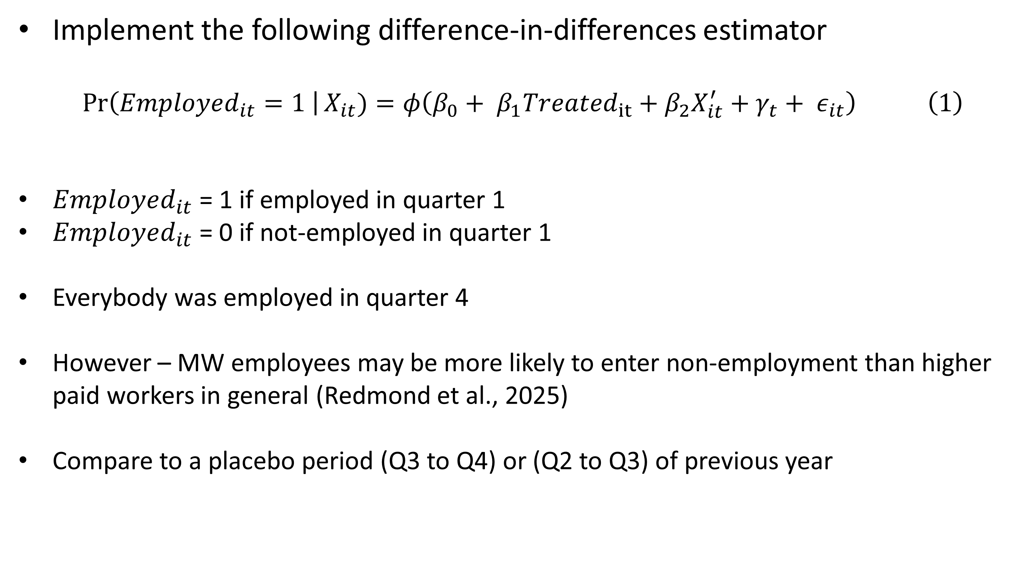
Methodology (I)
Implement the following difference-in-differences estimator
$$\operatorname{Pr}\left(Employed_{it}=1 \right|X_{it})=φ\left(β_{0}+ β_{1}{Treated}_{it}+β_{2}X_{it}^{′}+γ_{t}+ ε_{it}\right) \left(1\right)$$
$Employed_{it}$ = 1 if employed in quarter 1
$Employed_{it}$ = 0 if not-employed in quarter 1
Everybody was employed in quarter 4
However – MW employees may be more likely to enter non-employment than higher paid workers in general (Redmond et al., 2025)
Compare to a placebo period (Q3 to Q4) or (Q2 to Q3) of previous year

Slide 14
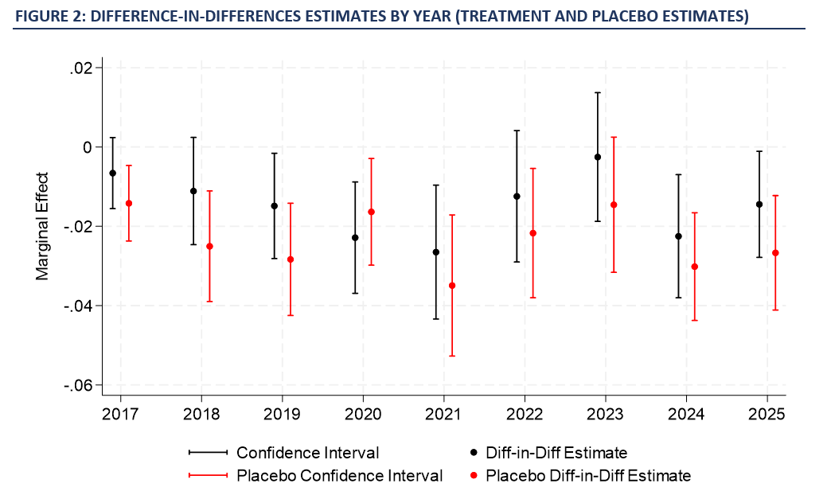
Results (I)

Slide 15
Alternative Control Group
From 2019, the LFS includes administrative earnings data for approximately 60% of the sample of employees
Use this to calculate an hourly wage rate
Reclassify those earning between old and new MW rate as treatment workers
Remove very high paid workers (earning 15% more than the increased MW)

Slide 16
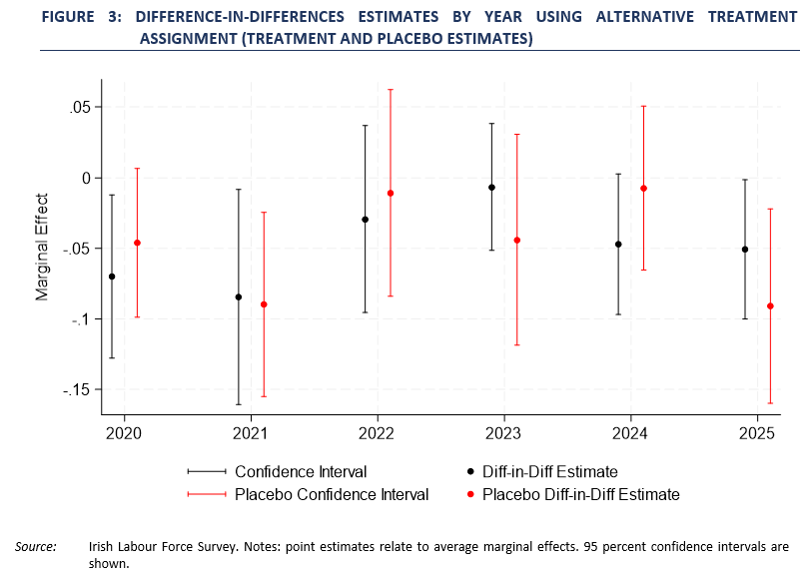
Alternative Control Group

Slide 17

Methodology (II)
The causal impact of ‘ageing into’ a higher MW band
Treatment group consist of individuals that fulfil three criteria
Aged between 18 and 20 in the current quarter
They earned a youth MW rate in the previous quarter
Their age changed between previous and current quarter
Control group – same apart from no birthday

Slide 18
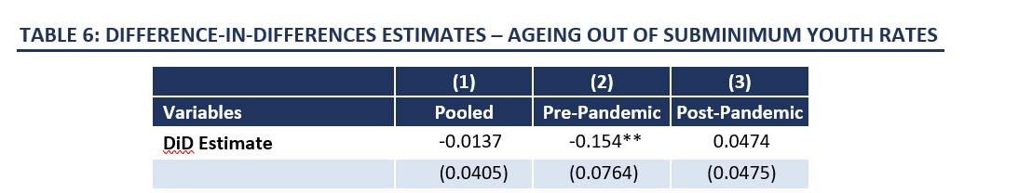
Results (II)

Slide 19
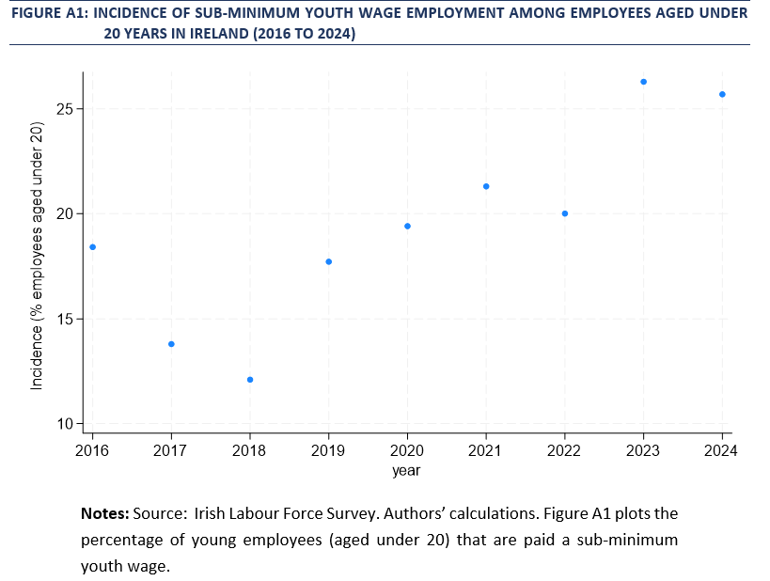
Results (II)

Slide 20
Conclusion
From 2015 to 2025, the minimum wage in Ireland increased by 56%
Our results show that increases to the MW have not led to an increased probability of job loss (up to 6 months after MW change)
Overall, ageing into a higher youth-rate band not associated with job loss
Cutting jobs does not appear to be a channel of adjustment for Irish employers for the years we look at (note – these years are generally characterized by low unemployment and strong economic growth)
Increasing reliance on sub-minimum youth wages

Slide 21






Thank you
paul.redmond@esri.ie
ESRI.ie
Economic and Social Research Institute (ESRI)
Economic and Social Research Institute (ESRI)
@ESRIDublin
Sign up to our Newsletter

