Slide 1

Applied Policy Evaluation
Dr Paul Redmond
Economic and Social Research Institute & Trinity College Dublin
MSc in Economic Policy

Slide 2
Causal Analysis
We are interested in the causal effect of policy X on some outcome Y
There are very useful estimators available to us (provided we have the data!)
We will focus on
  Difference-in-differences
  Regression discontinuity
  Instrumental variables
  Matching

Slide 3
Causal Analysis
Our aim
  Gain an intuitive understanding of the estimator
Show how the estimator is used in applied policy evaluation
The literature on these techniques is very large and constantly evolving
  What you learn here should allow you to dive deeper into the literature to examine recent innovations and more sophisticated techniques

Slide 4
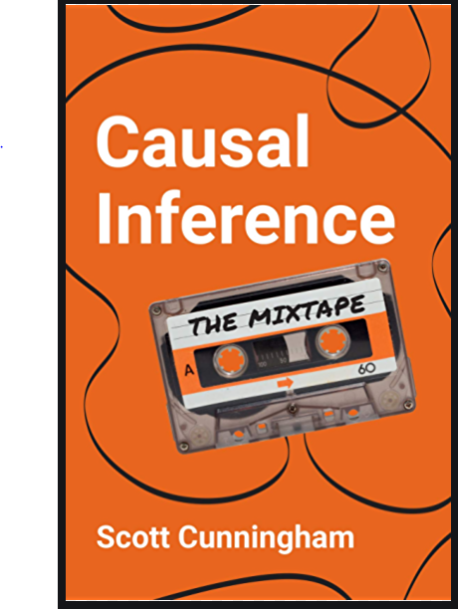



Applied Causal Analysis
Useful books

Slide 5
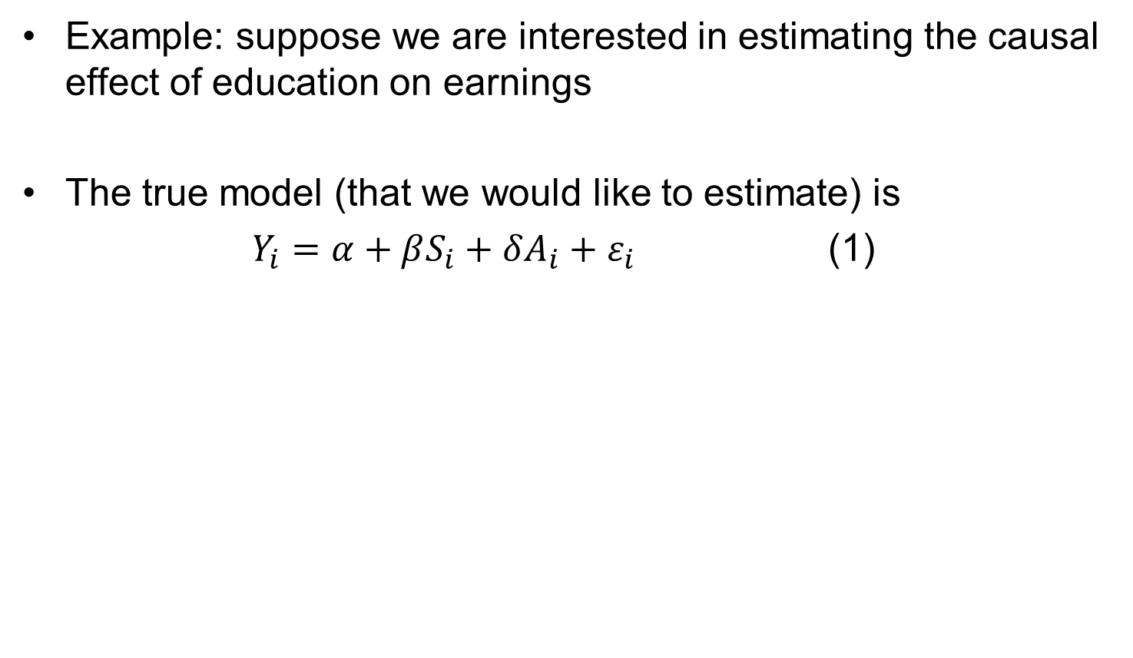
Why do we need these techniques?
Example: suppose we are interested in estimating the causal effect of education on earnings
The true model (that we would like to estimate) is
$Y_{i}=α+βS_{i}+δA_{i}+ε_{i}$ (1)

Slide 6
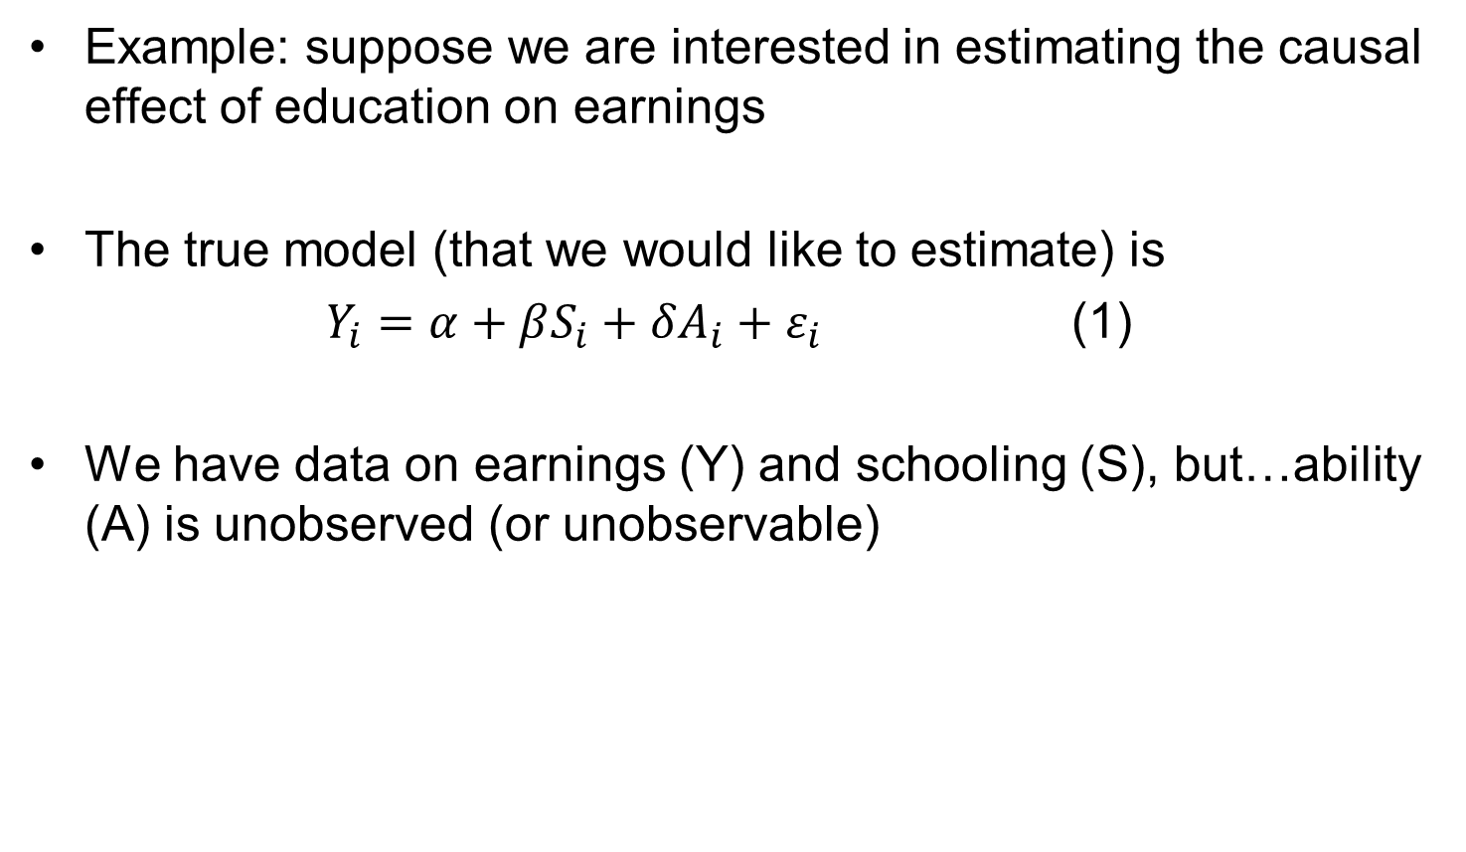
Why do we need these techniques?
Example: suppose we are interested in estimating the causal effect of education on earnings
The true model (that we would like to estimate) is
$Y_{i}=α+βS_{i}+δA_{i}+ε_{i}$ (1)
We have data on earnings (Y) and schooling (S), but…ability (A) is unobserved (or unobservable)

Slide 7
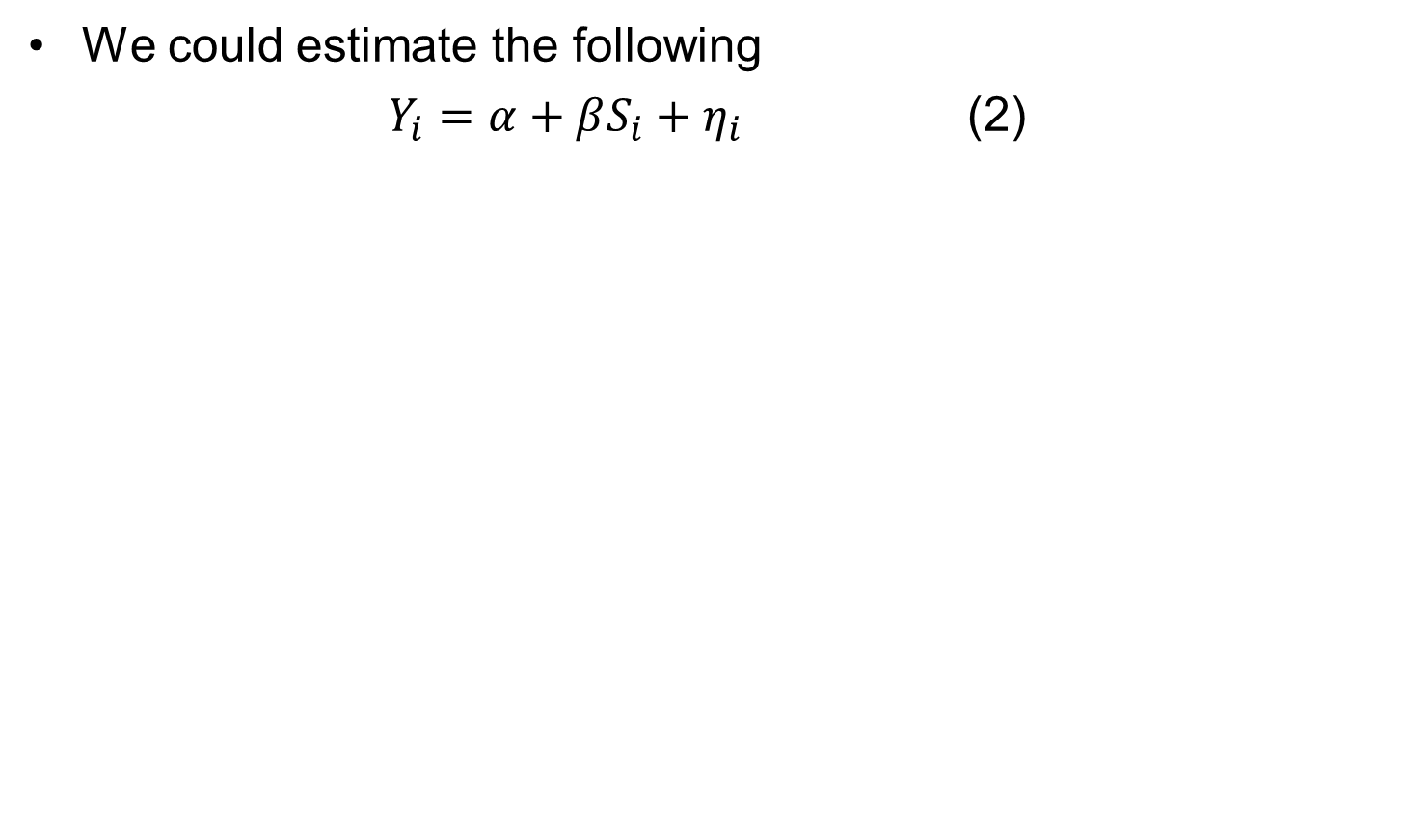
Why do we need these techniques?
We could estimate the following
$Y_{i}=α+βS_{i}+η_{i}$ (2)

Slide 8
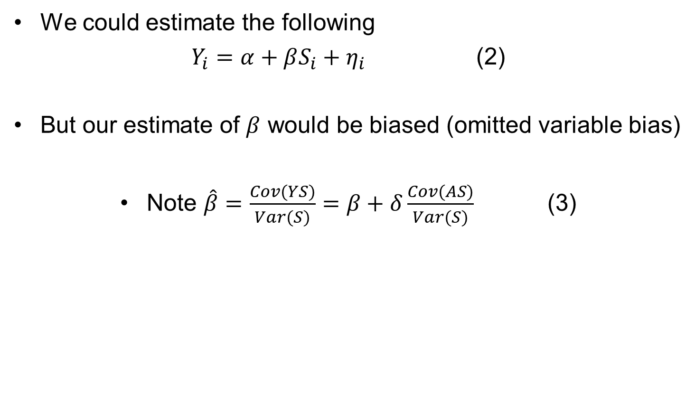
Why do we need these techniques?
We could estimate the following
$Y_{i}=α+βS_{i}+η_{i}$ (2)
But our estimate of $β$ would be biased (omitted variable bias)
Note $\hat{β}=\frac{Cov(YS)}{Var(S)}=β+δ\frac{Cov(AS)}{Var(S)}$ (3)

Slide 9
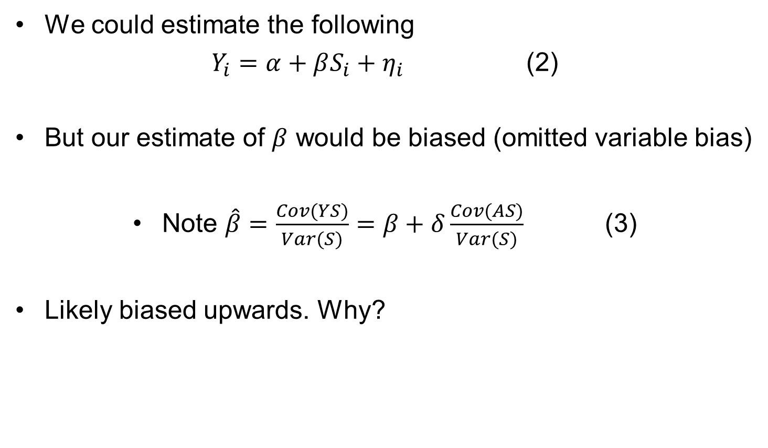
Why do we need these techniques?
We could estimate the following
$Y_{i}=α+βS_{i}+η_{i}$ (2)
But our estimate of $β$ would be biased (omitted variable bias)
Note $\hat{β}=\frac{Cov(YS)}{Var(S)}=β+δ\frac{Cov(AS)}{Var(S)}$ (3)
Likely biased upwards. Why?

Slide 10
Difference in differences

Slide 11
Difference-in-differences
Treatment occurs at some time point, t
Based on identifying a treatment and control group
  The treatment group gets the treatment (is impacted by the policy)
  The control group is not impacted by the policy
The DiD estimator takes the change in average outcomes among the treated group (pre- and post-treatment), and subtracts the change in average outcomes among the control group

Slide 12
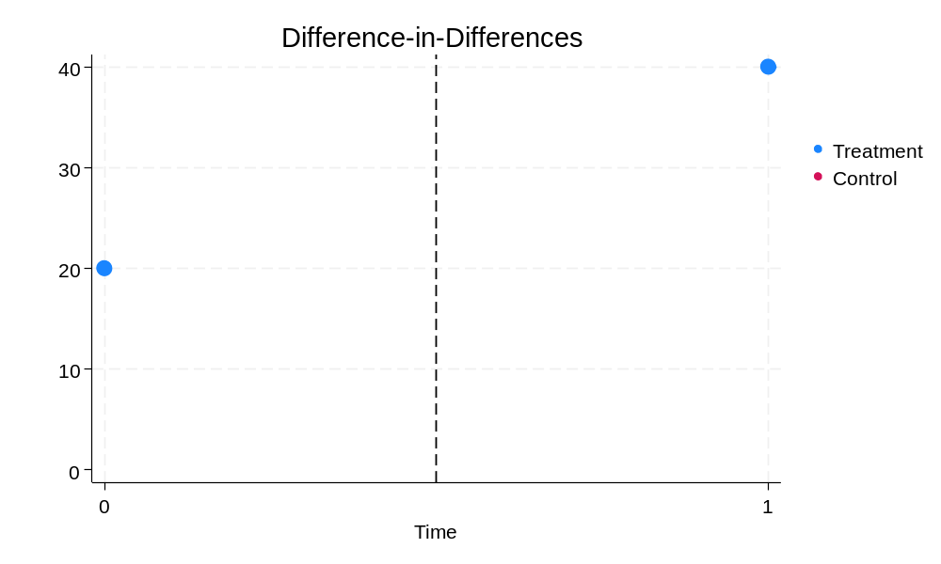
Graphical Explanation of DiD
A
B

Slide 13
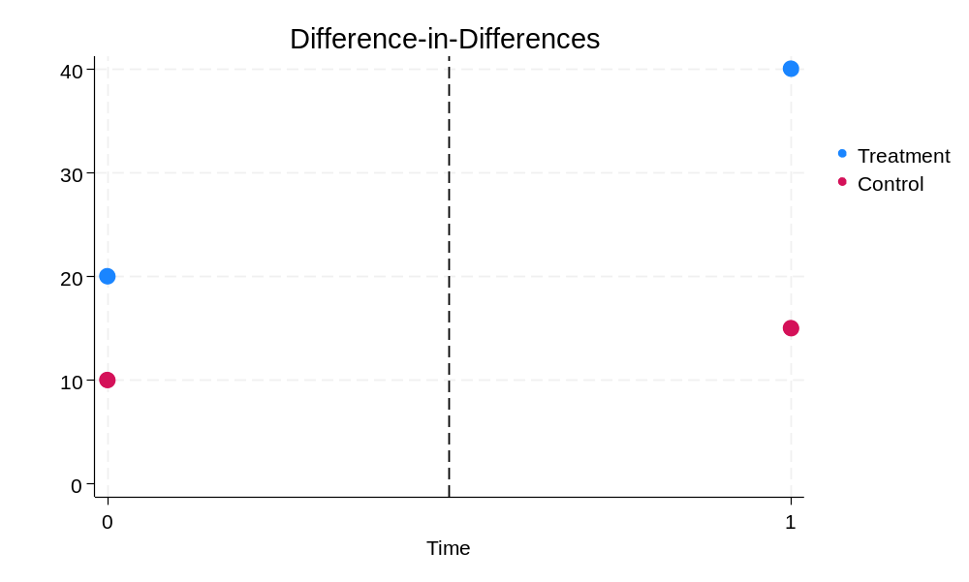
Graphical Explanation of DiD
A
B
C
D

Slide 14
Difference-in-differences
A graphical explanation of D-i-D
A
B
C
D
DiD = (A-B) – (C-D)

Slide 15
Question
You are asked to investigate the impact of a minimum wage increase on hours worked.
You have data for a ten-year period before the minimum wage increase (2005 to 2015). Assume there was no minimum wage change during this time.
You also have data for 2016, which was the year the minimum wage increased.
From that data, suppose you are presented with the following table….

Slide 16
Question
Year | Hours Min Wage | Hours Higher Paid
2005 | 30 | 39
2006 | 30 | 39
2007 | 30 | 39
2008 | 29.5 | 38.5
2009 | 29.5 | 38.5
2010 | 29 | 38
2011 | 29 | 38
2012 | 29 | 38
2013 | 28.5 | 37.5
2014 | 28.5 | 37.5
2015 | 28 | 37
2016 | 22 | 31
What is your best estimate of the causal effect of the 2016 minimum wage increase on hours worked?

Slide 17
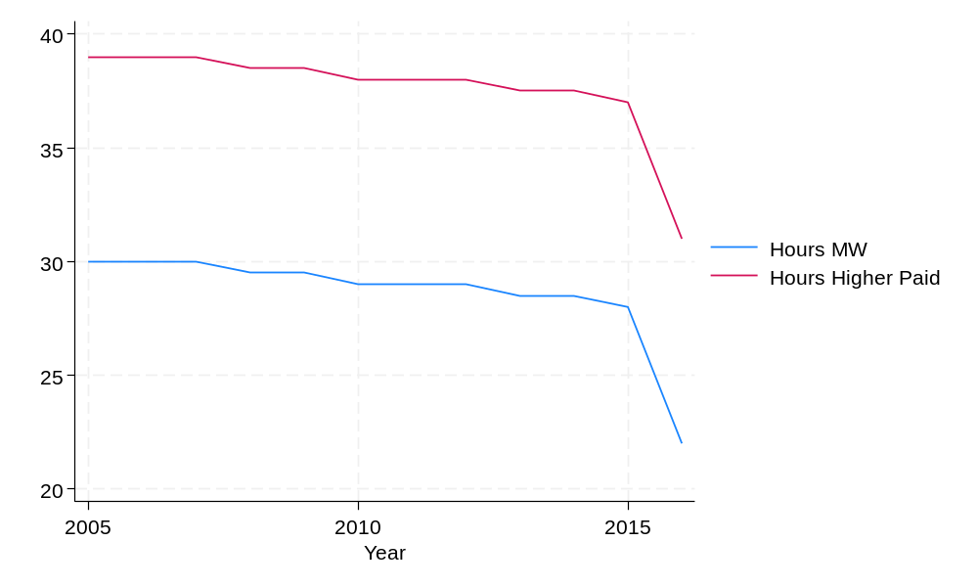
Question
What is your best estimate of the causal effect of the 2016 minimum wage increase on hours worked?

Slide 18
Question
Year | Hours Min Wage | Hours Higher Paid
2005 | 30 | 39
2006 | 30 | 39
2007 | 30 | 39
2008 | 29.5 | 38.5
2009 | 29.5 | 38.5
2010 | 29 | 38
2011 | 29 | 38
2012 | 29 | 38
2013 | 28.5 | 37.5
2014 | 28.5 | 37.5
2015 | 28 | 37
2016 | 22 | 36.5
What is your best estimate of the causal effect of the 2016 minimum wage increase on hours worked?

Slide 19
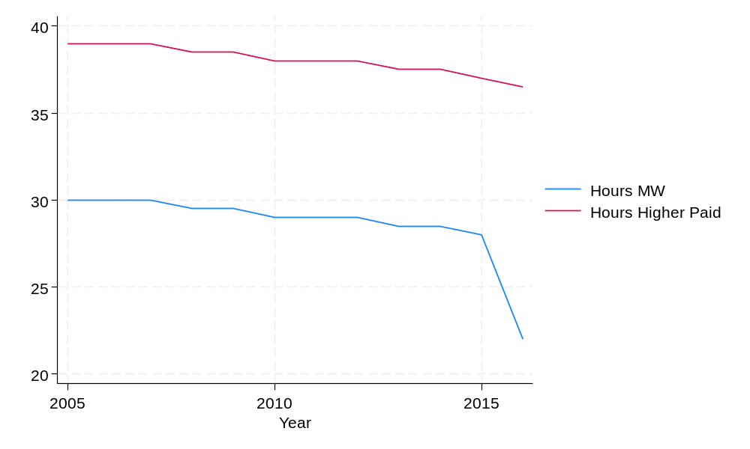
Question
What is your best estimate of the causal effect of the 2016 minimum wage increase on hours worked?

Slide 20
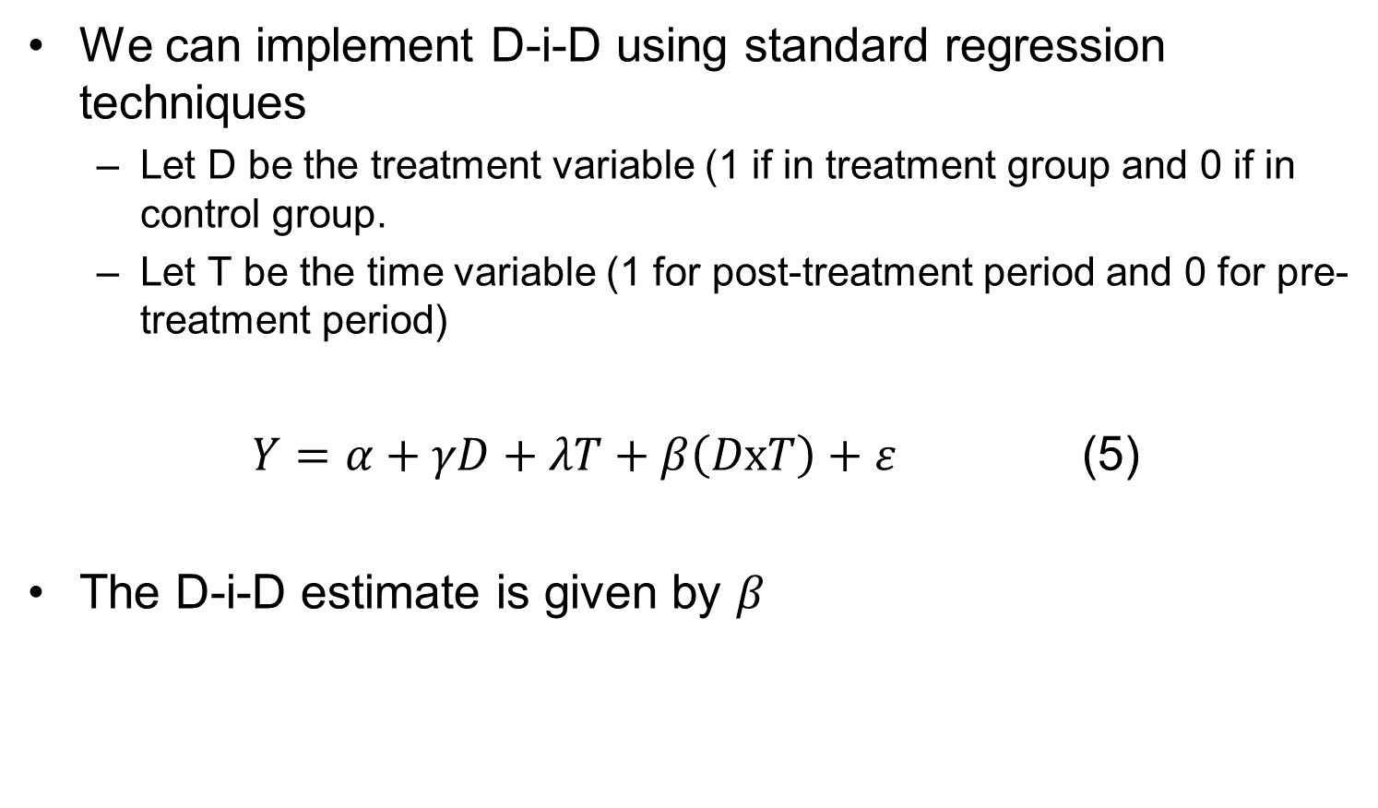
Difference-in-differences
We can implement D-i-D using standard regression techniques
  Let D be the treatment variable (1 if in treatment group and 0 if in control group.
  Let T be the time variable (1 for post-treatment period and 0 for pre-treatment period)
$Y=α+γD+λT+β\left(DxT\right)+ε$ (5)
The D-i-D estimate is given by $β$

Slide 21
Difference-in-differences
Parallel trends is a key assumption (often testable) in DiD
If the outcomes of the treatment and control group were diverging before the treatment occurred, this calls the validity of the estimator into question
If we have multiple pre-treatment years, we can test this
  At the very least, we could simply plot the averages for each year for the treatment and control group

Slide 22

Difference-in-differences
EXAMPLE 1

Slide 23
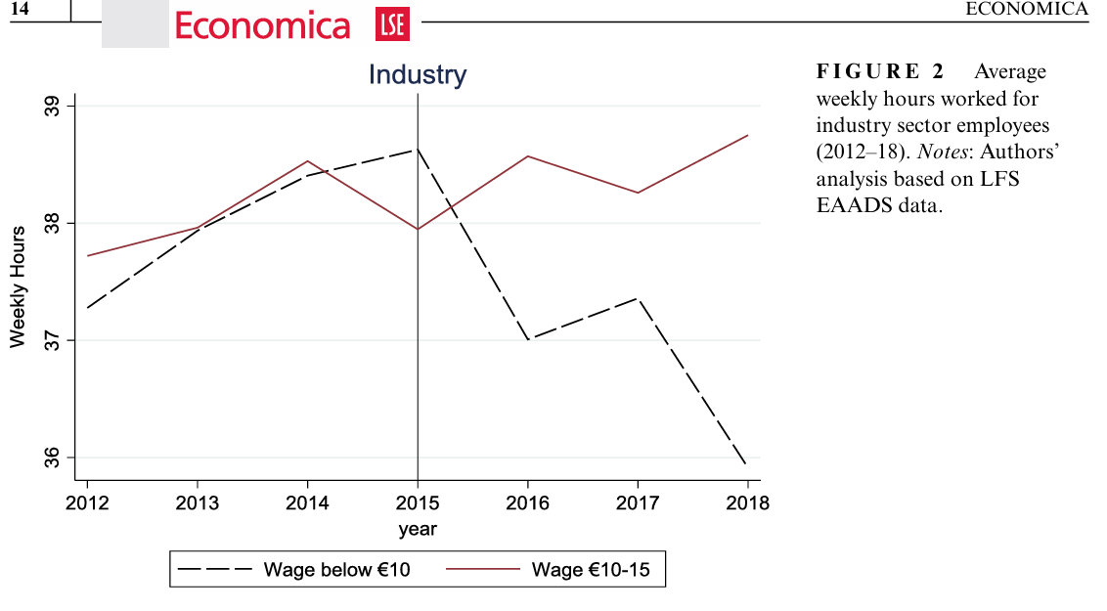
Difference-in-differences
EXAMPLE 1

Slide 24

Difference-in-differences
EXAMPLE 2: Redmond et al. (2022)

Slide 25
Difference-in-differences
EXAMPLE 2: Redmond et al. (2022)
Prior to 2012, lone parents in Ireland could receive One-Parent Family Payment until their youngest child was 18 years of age
This long duration and lack of activation was criticised nationally and internationally (OECD, 2003; Department of Social and Family Affairs, 2006)
  Culminated in the Troika attaching conditions to Ireland’s financial assistance programme (Regan et al., 2018)
The child qualifying age for OFP was subsequently reduced from 18 years to 7 years

Slide 26
Difference-in-differences
EXAMPLE 2: Redmond et al. (2022)
The aim of this paper is to evaluate the impact of this policy change (the qualifying age reduction) on labour market outcomes of impacted lone parents
  Average hours worked
  Probability of working
  Earnings
We use a difference-in-differences estimator
  Use SILC data from 2012 to 2017
Closest work is Avram et al. (2018)
  UK reform that lowered the age of the youngest child for cash benefit significantly increased the likelihood of a lone parent returning to work

Slide 27
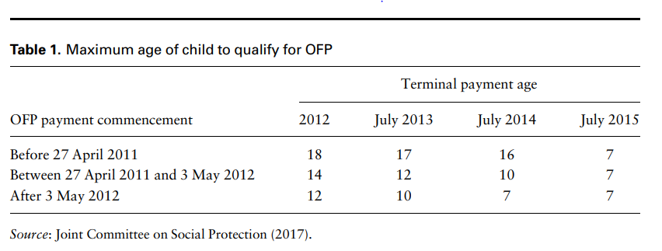
Difference-in-differences
EXAMPLE 2: Redmond et al. (2022)
Treatment group
  Lone parents whose youngest child is 7-9 years
Control group
  Lone parents whose youngest child < 7 years old

Slide 28
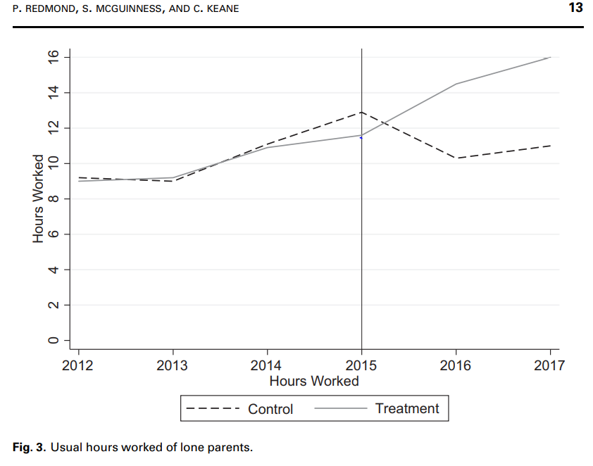
Difference-in-differences
EXAMPLE 2: Redmond et al. (2022)

Slide 29
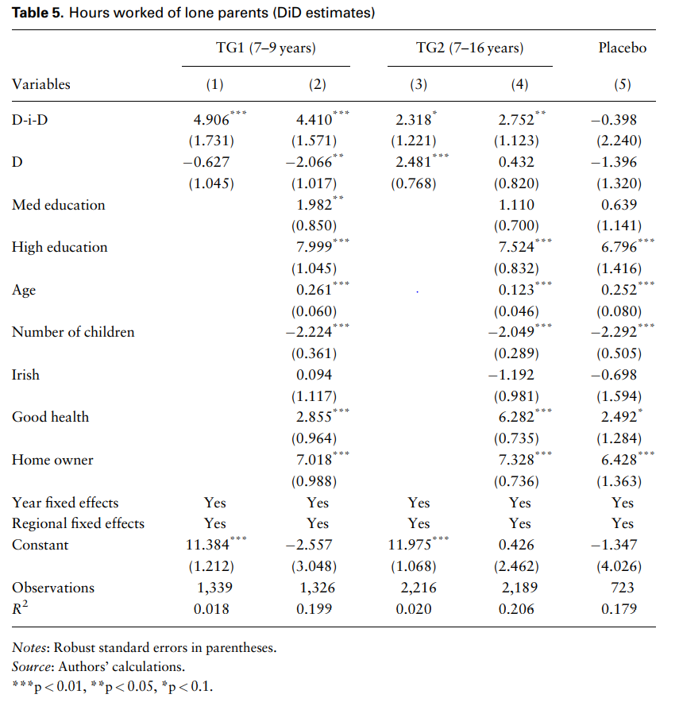
Difference-in-differences
EXAMPLE 2: Redmond et al. (2022)

Slide 30
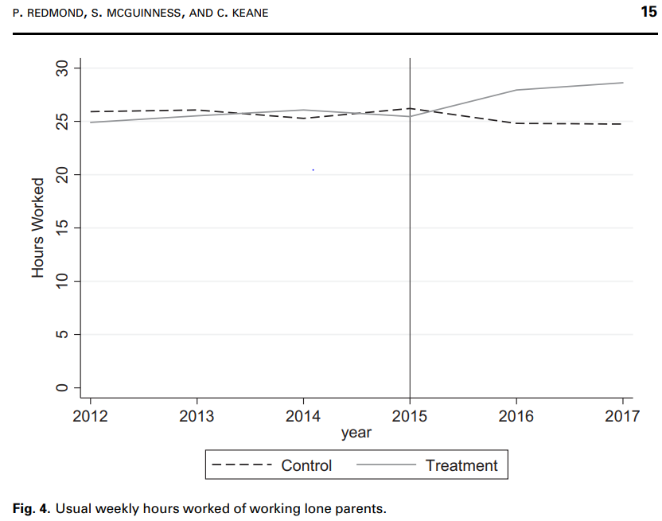
Difference-in-differences
EXAMPLE 2: Redmond et al. (2022)

Slide 31
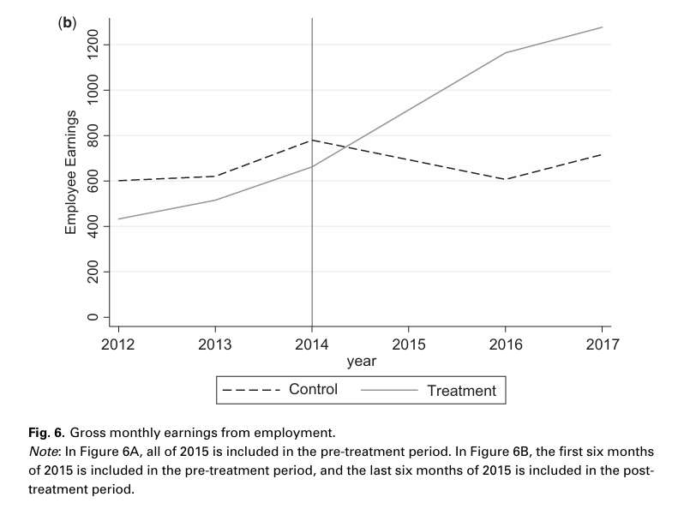
Difference-in-differences
EXAMPLE 2: Redmond et al. (2022)

Slide 32

Difference-in-differences
EXAMPLE 3: Kannan et al. (2023)

Slide 33
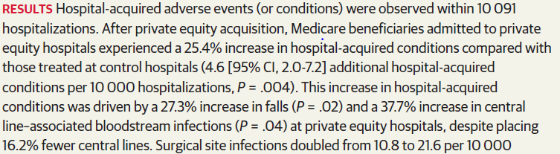
Difference-in-differences
EXAMPLE 3: Kannan et al. (2023)

Slide 34
Regression Discontinuity

Slide 35
Regression Discontinuity
Regression discontinuity design (RDD) is a quasi-experimental design that allows for identification of treatment effects when assignment to the treatment changes discontinuously

Slide 36
Regression Discontinuity
EXAMPLE 1 (and first use): Thistlewaite and Campbell (1960)
  Thistlewaite, D. and Campbell, D. (1960), “Regression-discontinuity analysis: An alternative to the ex post facto experiment.”, Journal of Educational Psychology, vol. 51 (6): pp.309-317
Used to evaluate the causal effect of certificates of merit (CoM)
Basic idea: bare winners and bare losers should be identical in all aspects except the bare winners got the CoM
Therefore, comparing subsequent outcomes, gives the causal effect of CoM

Slide 37
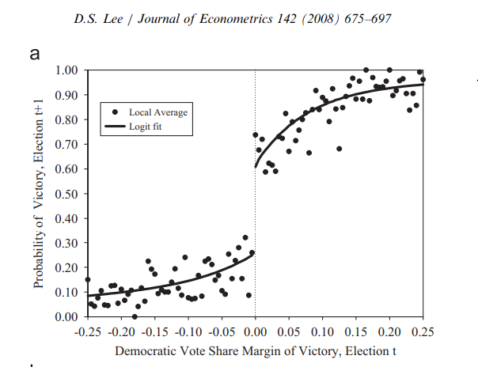
Regression Discontinuity
EXAMPLE 2
Another famous example of RD design is Lee (2008)
  Lee, D.S. (2008), “Randomized experiments from non-random selection in US House elections”, Journal of Econometrics, vol. 142 (2): pp 675-697

Slide 38
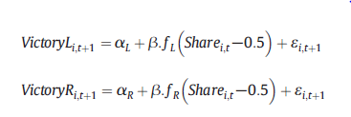
Regression Discontinuity
How do we implement RD?
  Let’s apply it to the previous graph by Lee (2008)
Outcomes are estimated separately for those to the right and left of the threshold
Note that we subtract the threshold value (0.5) from the forcing variable
  This means the treatment effect equals
We don’t have to run two regressions – we can estimate this in a single pooled model

Slide 39
Regression Discontinuity
Validity of the RD design is based on the assumption that treatment assignment is approximately random at the threshold
This implies that “bare winners” and “bare losers” should differ only in their treatment status and other pre-treatment covariates should be continuous at the threshold
We can test this by checking for discontinuities in observable pre-treatment characteristics

Slide 40

Regression Discontinuity
EXAMPLE 3

Slide 41
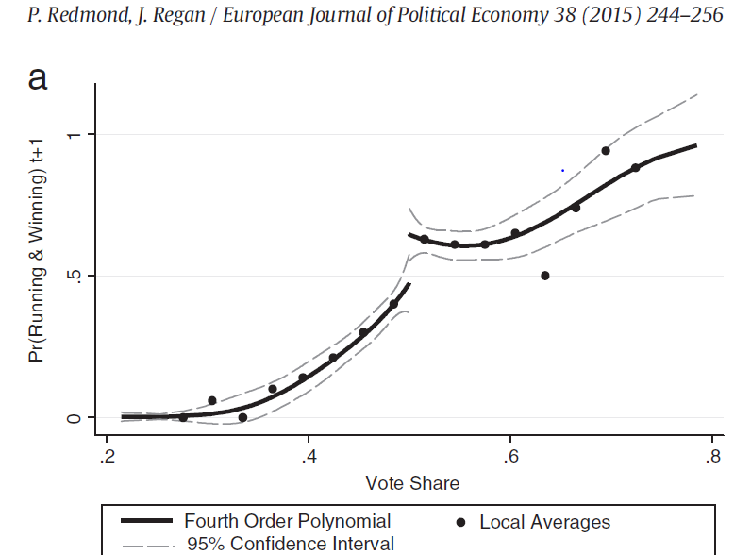
Regression Discontinuity

Slide 42

Regression Discontinuity
EXAMPLE 4

Slide 43
Regression Discontinuity
EXAMPLE 4 cont’d
In 2014, the qualifying age for the contributory state pension increased from 65 to 66 years
  The transition state pension was abolished
Implementation of the policy in 2014 was based on a person’s date of birth
  Those born before January 1949 could still qualify at age 65
  Those born on or after 1 January 1949 had to wait until age 66
For example,
  A 65-year-old in 2014 who was born in December 1948 could receive the transition state pension
  A 65-year-old in 2014 who was born in January 1949 could not receive the transition state pension

Slide 44
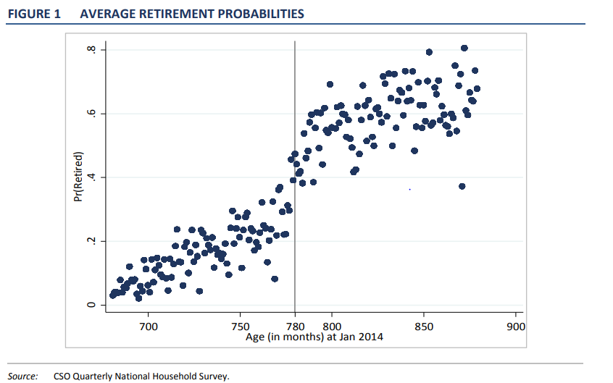
Regression Discontinuity
EXAMPLE 4 cont’d

Slide 45
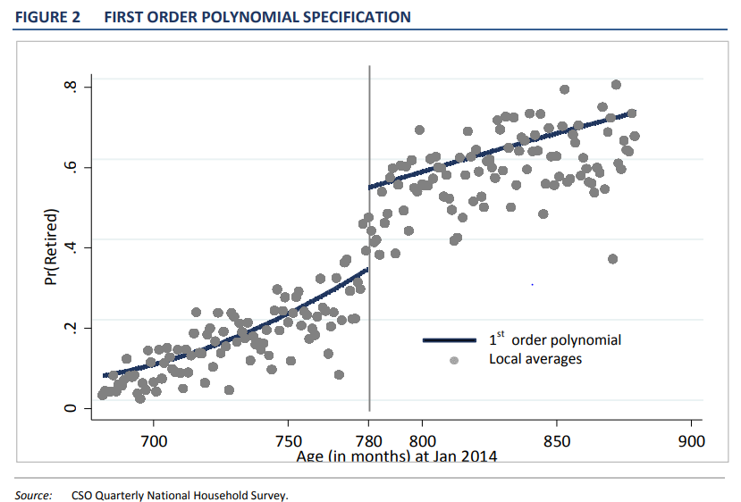
Regression Discontinuity
EXAMPLE 4 cont’d

Slide 46
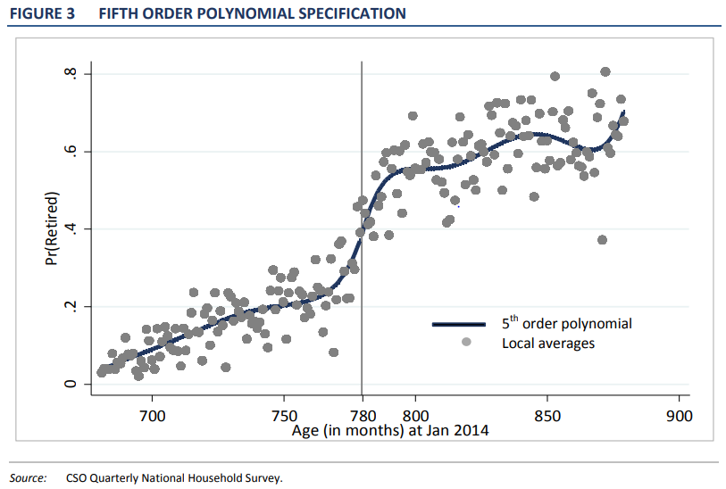
Regression Discontinuity
EXAMPLE 4 cont’d

Slide 47
Regression Discontinuity
EXAMPLE 4 cont’d
No clear evidence of a causal effect of the policy change on retirement rates
Several potential reasons
  Retirement norms / expectations unchanged
  Occupational pensions unchanged
  Jobseeker’s Benefit seen as a de-facto pension payment

Slide 48
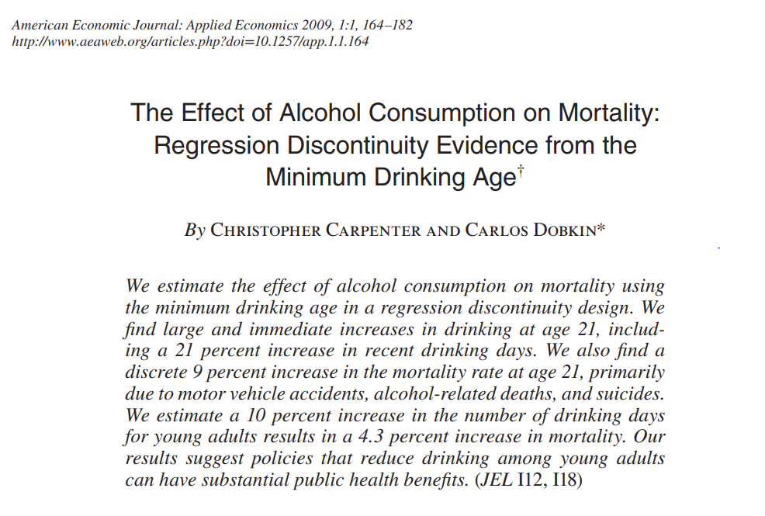
Regression Discontinuity
EXAMPLE 5

Slide 49
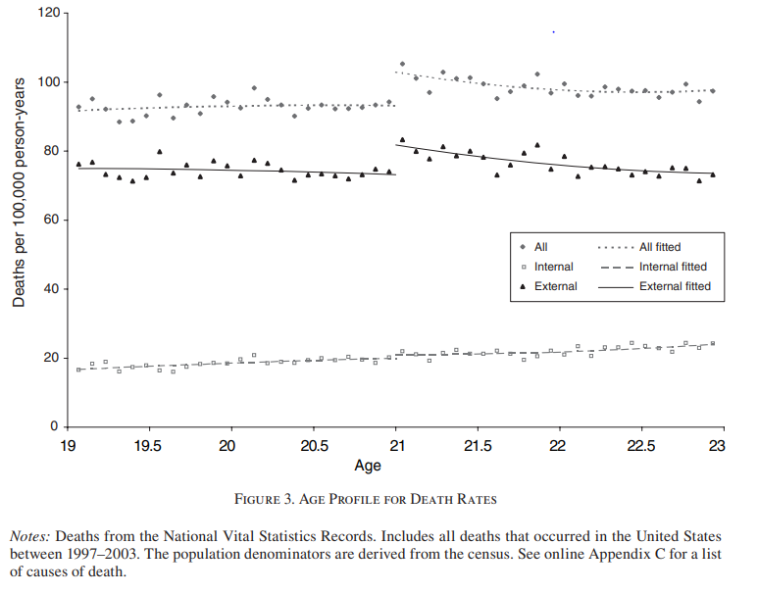
Regression Discontinuity
EXAMPLE 5 cont’d

Slide 50
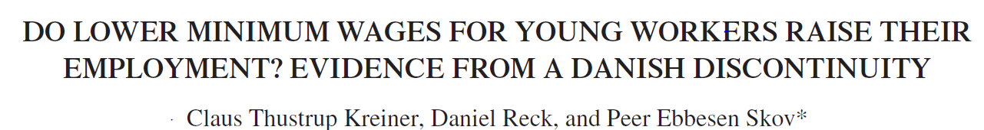
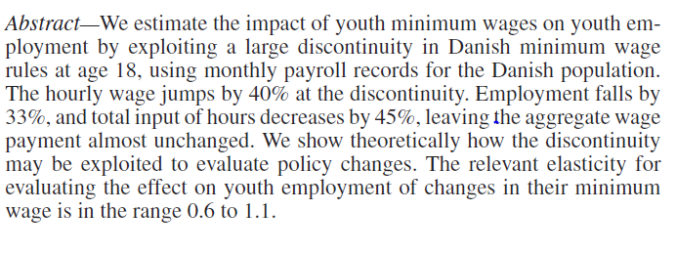
Regression Discontinuity
EXAMPLE 6 cont’d

Slide 51
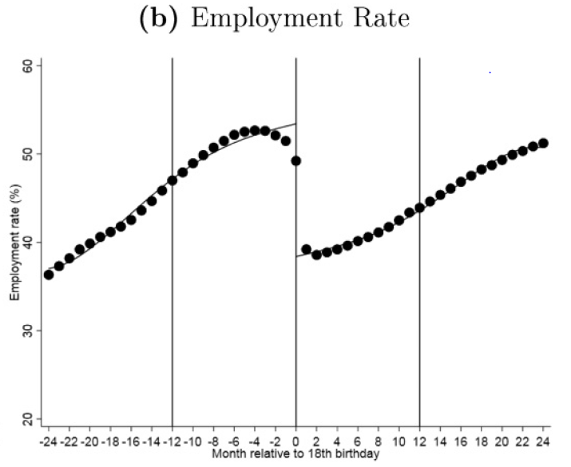
Regression Discontinuity
EXAMPLE 6 cont’d

Slide 52
Instrumental Variables

Slide 53
Instrumental Variables
Suppose you are given the following information…
You have data on how close a person lives to college. Let’s call this variable “Z”. You know that the closer a person lives to college, the more education they are likely to acquire.
Specifically, a one unit increase in Z is associated with 0.2 more years of education and $500 higher earnings.
Could you estimate the causal effect of one additional year of education on earnings from this information?

Slide 54
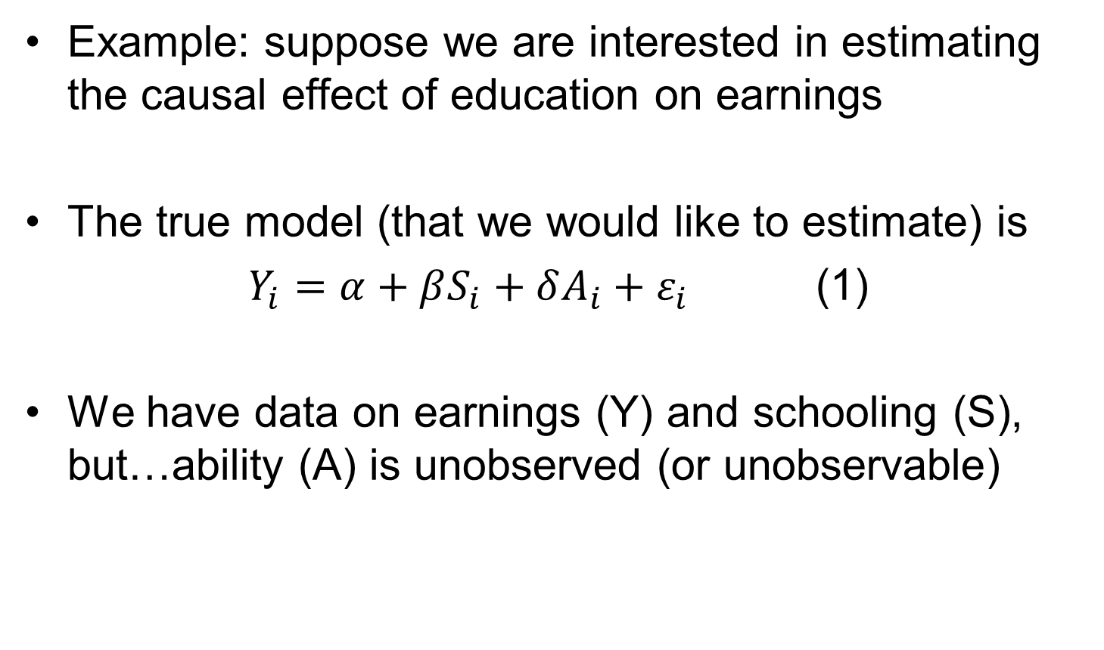
Instrumental Variables
Example: suppose we are interested in estimating the causal effect of education on earnings
The true model (that we would like to estimate) is
$Y_{i}=α+βS_{i}+δA_{i}+ε_{i}$ (1)
We have data on earnings (Y) and schooling (S), but…ability (A) is unobserved (or unobservable)

Slide 55
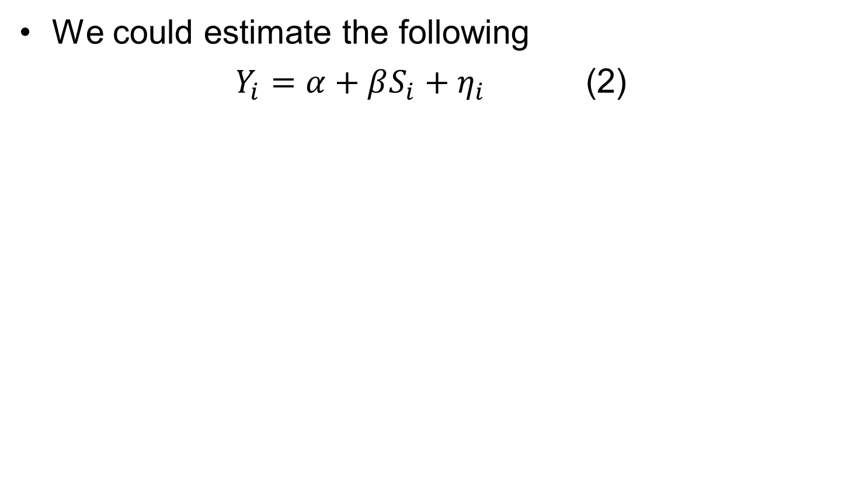
Instrumental Variables
We could estimate the following
$Y_{i}=α+βS_{i}+η_{i}$ (2)

Slide 56
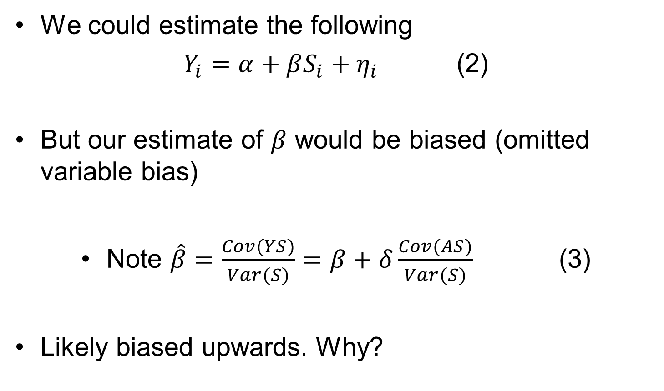
Instrumental Variables
We could estimate the following
$Y_{i}=α+βS_{i}+η_{i}$ (2)
But our estimate of $β$ would be biased (omitted variable bias)
Note $\hat{β}=\frac{Cov(YS)}{Var(S)}=β+δ\frac{Cov(AS)}{Var(S)}$ (3)
Likely biased upwards. Why?

Slide 57
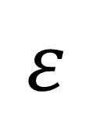
Instrumental Variables
The solution? (provided we have an instrument, Z)
We want an instrument that is strongly correlated with S
And…. only affects Y through its impact on S (exclusion restriction)
Z
S
Y
$$ε$$

Slide 58
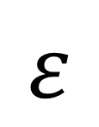
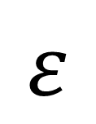
Instrumental Variables
A graphical summary of the problem
Ideally, we want
But we have (the problem)
S
Y
$$ε$$
S
Y
$$ε$$

Slide 59
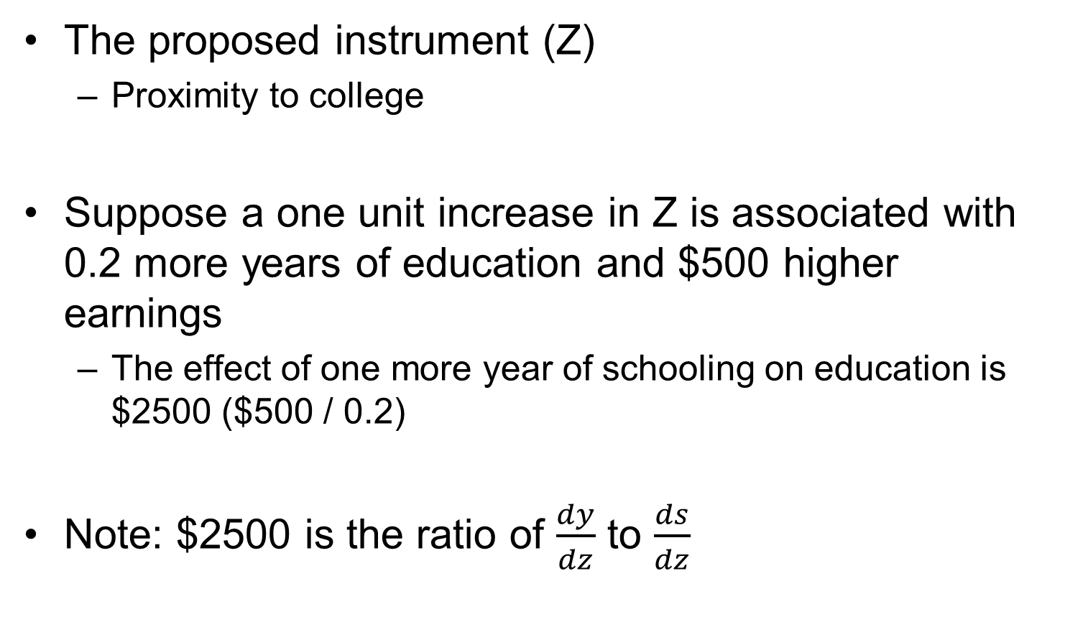
Instrumental Variables
The proposed instrument (Z)
  Proximity to college
Suppose a one unit increase in Z is associated with 0.2 more years of education and $500 higher earnings
  The effect of one more year of schooling on education is $2500 ($500 / 0.2)
Note: $2500 is the ratio of $\frac{dy}{dz}$ to $\frac{ds}{dz}$

Slide 60
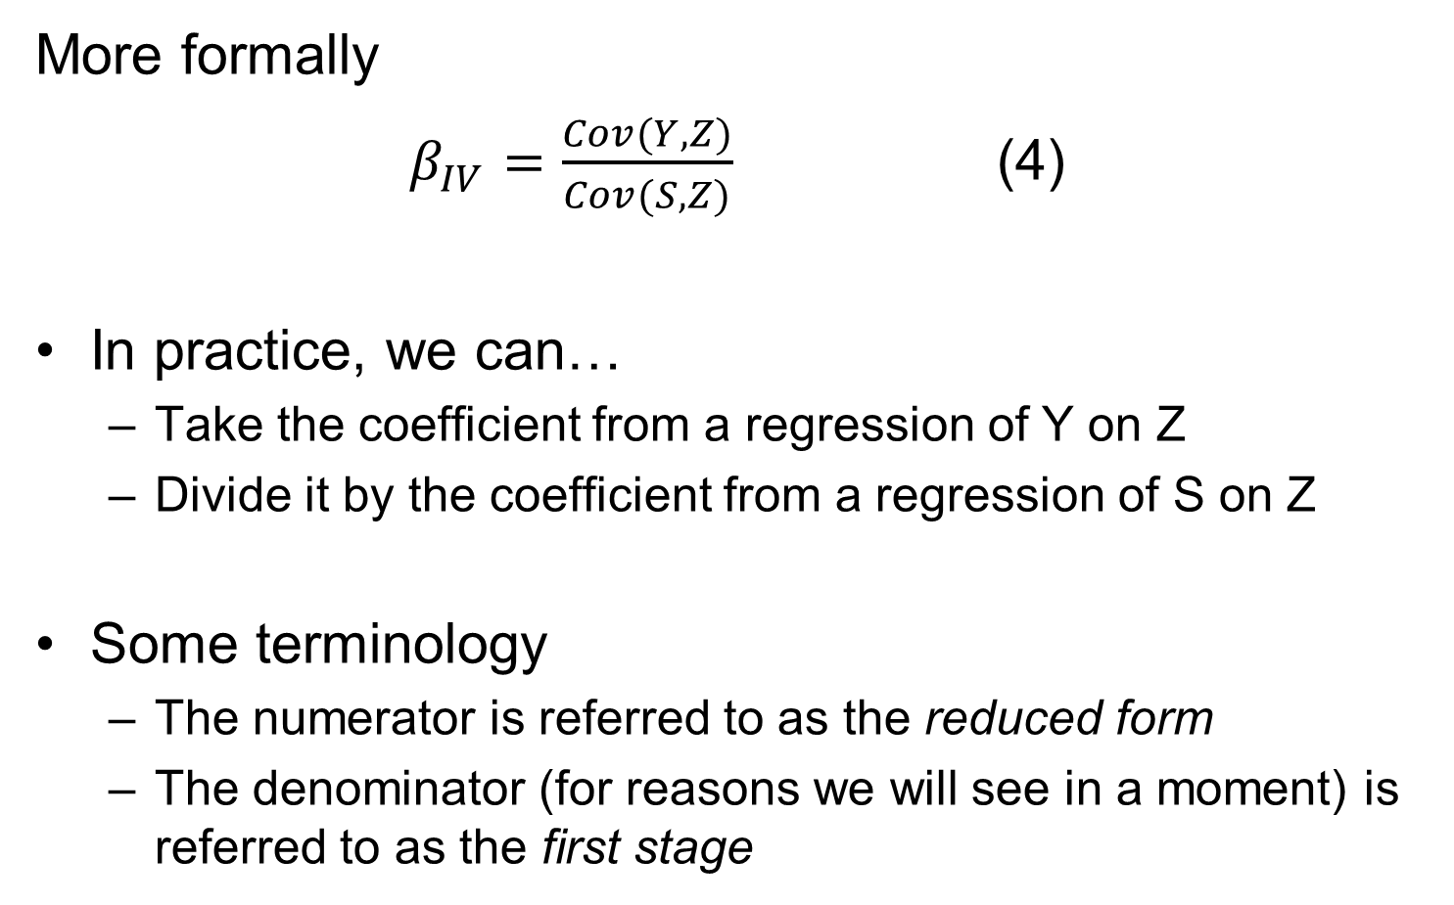
Instrumental Variables
More formally
$β_{IV}=\frac{Cov(Y,Z)}{Cov(S,Z)}$ (4)
In practice, we can…
  Take the coefficient from a regression of Y on Z
  Divide it by the coefficient from a regression of S on Z
Some terminology
  The numerator is referred to as the reduced form
  The denominator (for reasons we will see in a moment) is referred to as the first stage

Slide 61
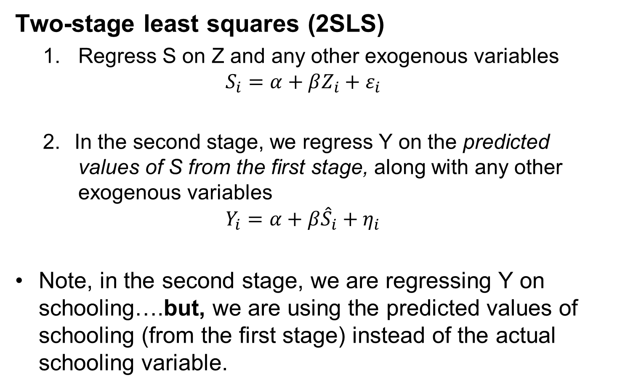
Instrumental Variables
Two-stage least squares (2SLS)
  Regress S on Z and any other exogenous variables
  $$S_{i}=α+βZ_{i}+ε_{i}$$
  In the second stage, we regress Y on the predicted values of S from the first stage, along with any other exogenous variables
  $$Y_{i}=α+β{\hat{S}}_{i}+η_{i}$$
Note, in the second stage, we are regressing Y on schooling….but, we are using the predicted values of schooling (from the first stage) instead of the actual schooling variable.

Slide 62
Instrumental Variables
By using the predicted values in the second stage
  We are using only the variation in S that is exogenous. This is good, as endogeneity should no longer be an issue
However, we are using only a subset of the variation in S and
This variation comes only from those whose behaviour was affected by the instrument
  We are estimating the local average treatment effect (LATE)

Slide 63

Instrumental Variables
Example 1

Slide 64

Instrumental Variables
Example 2

Slide 65
Propensity Score Matching (PSM)

Slide 66
Matching
Consider some treatment, D
We observe a group that were exposed to the treatment, and group that were not
As usual, we are interested in the causal effect of the treatment
And as usual, we have to think about confounders…other variables that are correlated with both the treatment and the outcome

Slide 67
Matching
Let’s think about an example
Early research on smoking sought to establish whether there was a causal effect between smoking and mortality
Source: Cochran (1968), in Scott Cunningham, The Mixtape
Smoking Group | Deaths per 1000 (in the US)
Cigarettes | 13.5
Cigars / pipes | 17.4

Slide 68
Matching
Let’s think about an example
Early research on smoking sought to establish whether there was a causal effect between smoking and mortality
Source: Cochran (1968), in Scott Cunningham, The Mixtape
Do you think it is reasonable to suggest that cigars and pipes cause a higher mortality rate than cigarettes?
Smoking Group | Deaths per 1000 (in the US)
Cigarettes | 13.5
Cigars / pipes | 17.4

Slide 69
Matching
Age is an important variable
Source: Cochran (1968), in Scott Cunningham, The Mixtape
Smoking Group | Mean age (in years)
Cigarettes | 53.2
Cigars / pipes | 59.7

Slide 70
Matching
Age is an important variable
Source: Cochran (1968), in Scott Cunningham, The Mixtape
What would mortality rates look like if cigarette smokers had the same age profile as cigar/pipe smokers?
Smoking Group | Mean age (in years)
Cigarettes | 53.2
Cigars / pipes | 59.7
Smoking Group | Age-adjusted deaths per 1000 (in the US)
Cigarettes | 21.2
Cigars / pipes | 13.7
Source: Cochran (1968), in Scott Cunningham, The Mixtape

Slide 71

Matching
As a starting point, we can think of a simple matching estimator that involves matching on one variable (e.g., age)

Slide 72
Matching
As a starting point, we can think of a simple matching estimator that involves matching on one variable (e.g., age)
Sticking with previous example…
Match each smoker to a non-smoker of the same (similar) age. Calculate the mean difference in outcomes
What if more than one counterfactual observation (similar non-smoker)?
Average over multiple counterfactuals
Randomly select a small group and take the average (e.g., 2)

Slide 73
Propensity Score Matching
What if, instead of just one, we want to match on lots of different covariates?
We can use propensity score matching
Rosenbaum and Rubin (1983) showed that If treatment assignment is independent of potential outcomes given covariates (strong ignorability), then it's also independent given the propensity score.

Slide 74
Propensity Score Matching
Two stages to PSM
A logit model is used to estimate a unit’s probability of being treated (propensity score)
Treated and control units are matched, based on their propensity scores, and the outcomes of both groups are compared
Relies on common support
We need units in the treatment and control group with the same propensity scores
Why? Because matching only works if you have somebody to match to.
If there is no control unit similar to a treated unit (in terms of covariates or propensity scores), this leads to bad matches and bad estimates

Slide 75

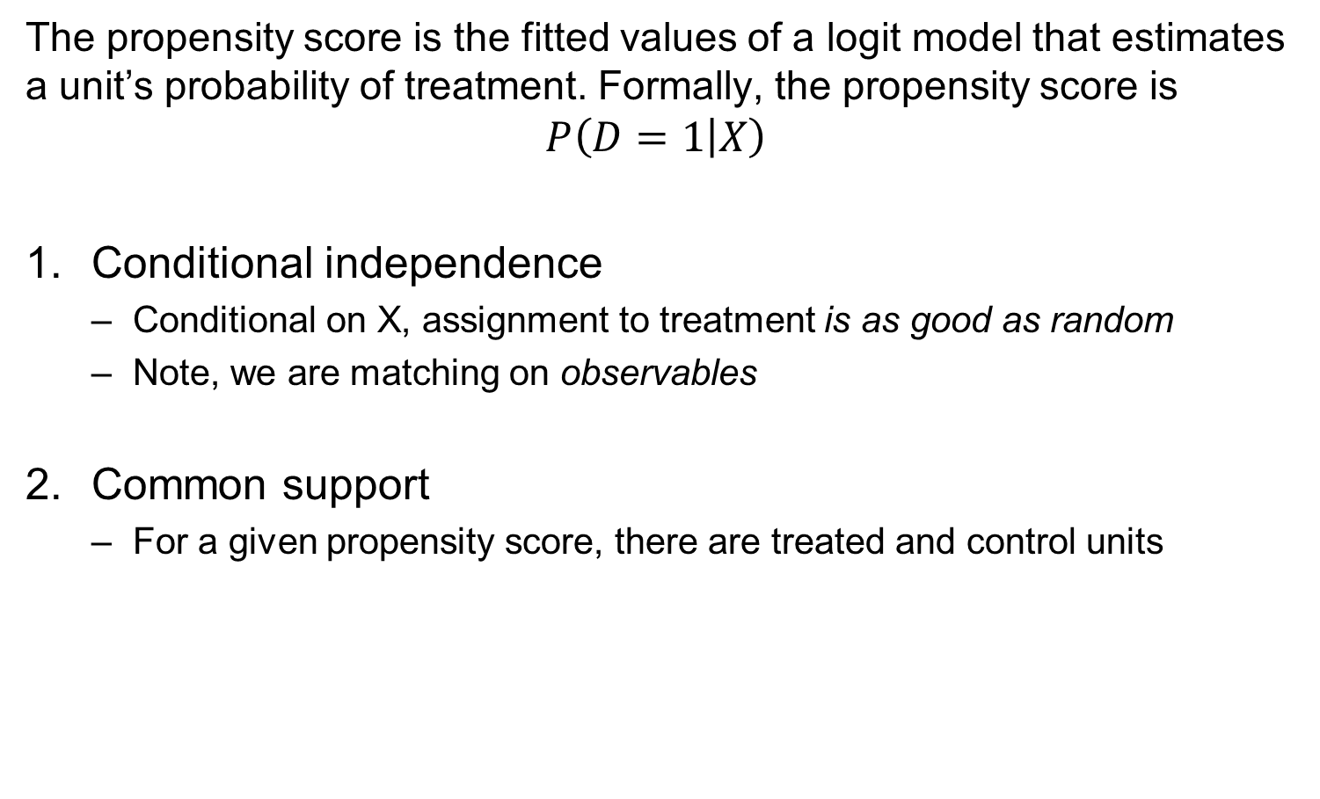
Propensity Score Matching
The propensity score is the fitted values of a logit model that estimates a unit’s probability of treatment. Formally, the propensity score is
$$P\left(D=1 | X\right)$$
Conditional independence
  Conditional on X, assignment to treatment is as good as random
  Note, we are matching on observables
Common support
  For a given propensity score, there are treated and control units

Slide 76
Propensity Score Matching
By comparing matched individuals, we can calculate an ATET and / or ATE
There are some practical considerations / options
Nearest neighbour
How many? Stata default (using teffects psmatch) is one
Caliper size
  Maximum allowable difference between the propensity scores of treated and control units
  Default in teffects psmatch is no caliper, so you could get poor matches
  Replacement

Slide 77
Propensity Score Matching
An example
use http://ssc.wisc.edu/sscc/pubs/files/psm
True treatment effect is 1
Run a regression and you get close
reg y x1 x2 t
Implement PSM
teffects psmatch (y) (t x1 x2)
Visually explore overlap between x1 and the treatment groups
twoway (scatter y x2 if t==0) (scatter y x2 if t==1)

